Slide 1

Notes:
https://www.vox.com/2016/4/25/11503152/shipping-routes-map
https://support.office.com/en-us/article/what-s-new-in-excel-2016-for-windows-5fdb9208-ff33-45b6-9e08-1f5cdb3a6c73?ui=en-US&rs=en-US&ad=US

Slide 2
Plan for this week
Tuesday:
Zonal Operations
Thursday:
More use cases
Pop quiz?

Slide 3
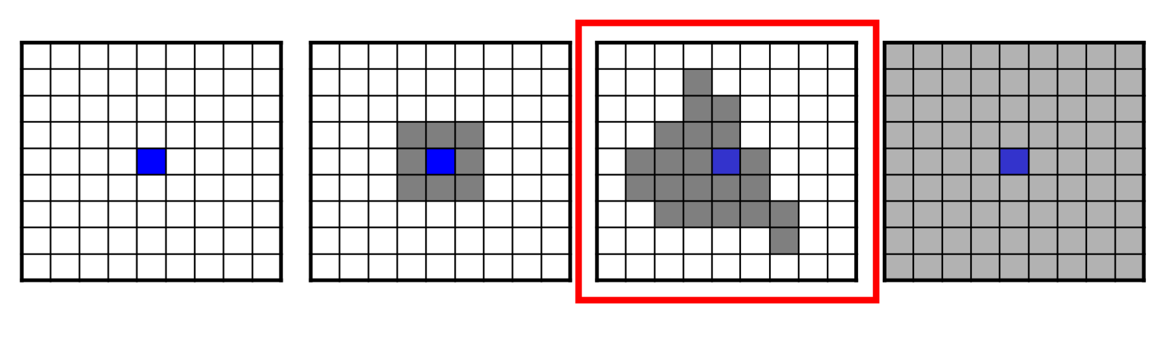
The cartographic modeling framework
Raster operations are grouped as local, focal, zonal, and global according to the spatial scope of the operation.

Slide 4
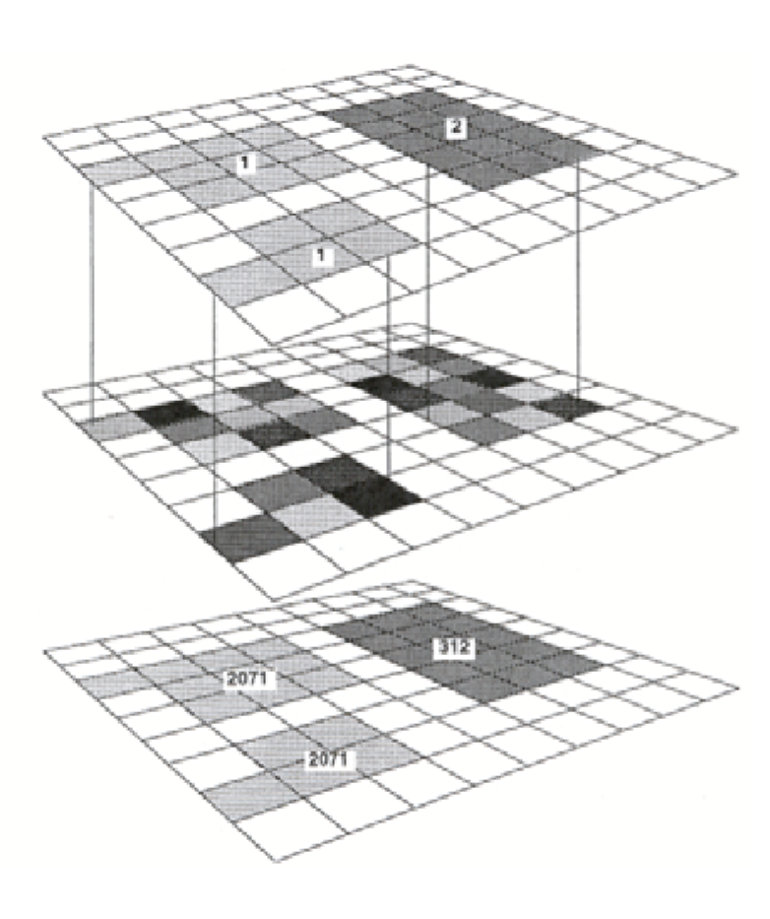
Zonal operations
Compute a new value for each cell as a function of the cell values within a zone containing the cell
Zone layer
Defines zones
Value layer
Defines inputs

Slide 5
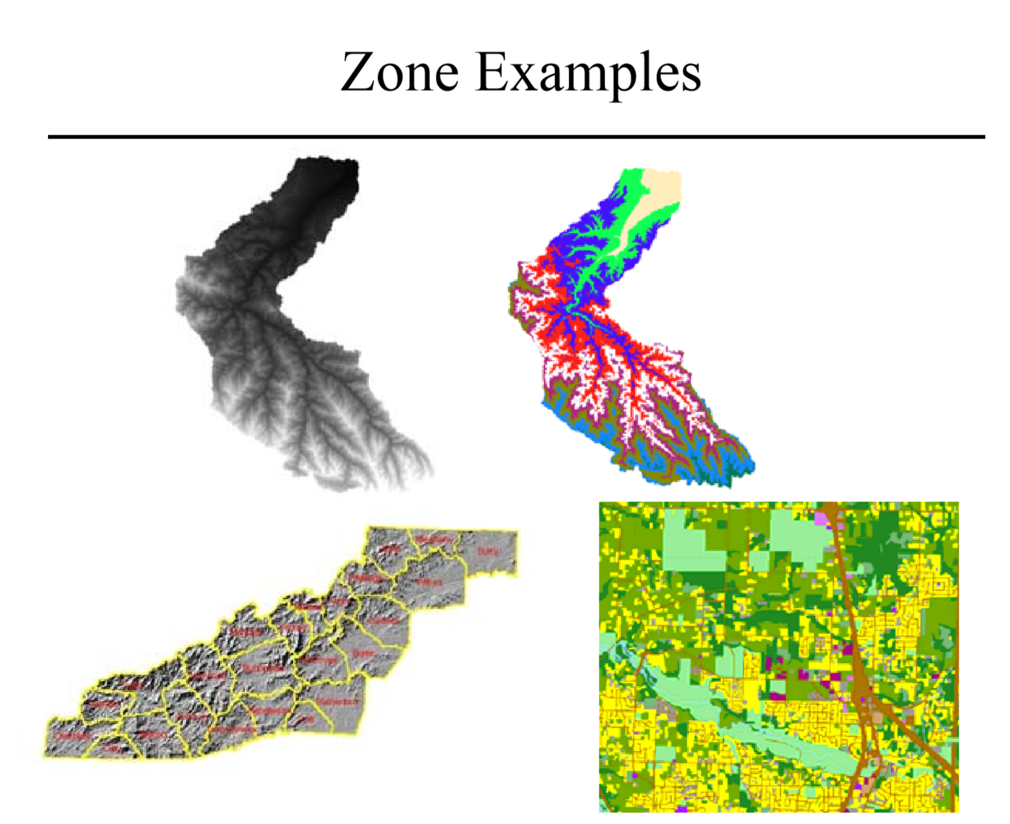

Slide 6
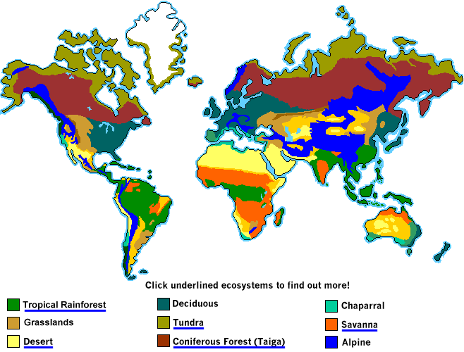
Characteristics of a zone
A mutually exclusive division of space
Zones usually do not overlap
A zone can be noncontiguous
Represented by cells with the same value
Notes:
https://i.pinimg.com/originals/0d/6f/e6/0d6fe667de37677cbb0bcac0712ce82d.jpg

Slide 7
Zonal statistical operations
Calculate statistics for each cell by using all the cell values within a zone
Operations can include(not limited to):
ZonalSum, ZonalMean, ZonalMedian, ZonalMaximum, ZonalMode, ZonalStandardDev, ZonalRange…

Slide 8
OUTPUTS OF Zonal operations
Raster layer
All the cells within a zone have the new output for that zone
Table
Each row in the table contains the statistics for a zone
The first column in arcGIS is the value of the zone
The table can be joined back into the zone layer

Slide 9
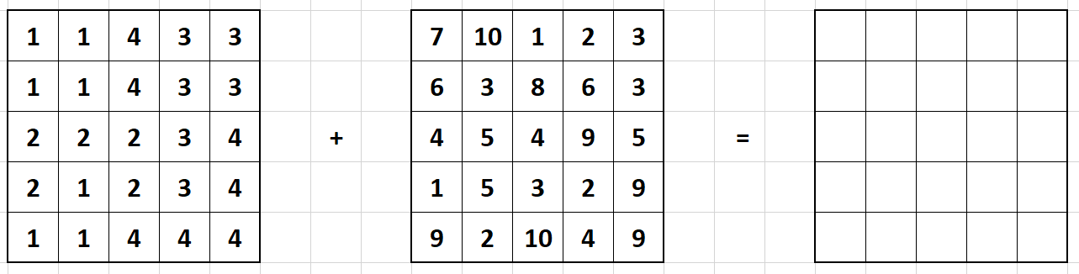
ZONES
Input
Output

Slide 11



Slide 12


Slide 13



Slide 14
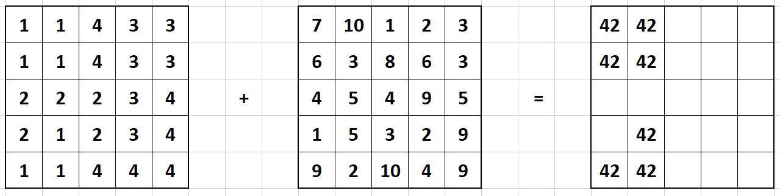

Slide 16


Slide 18


Slide 19
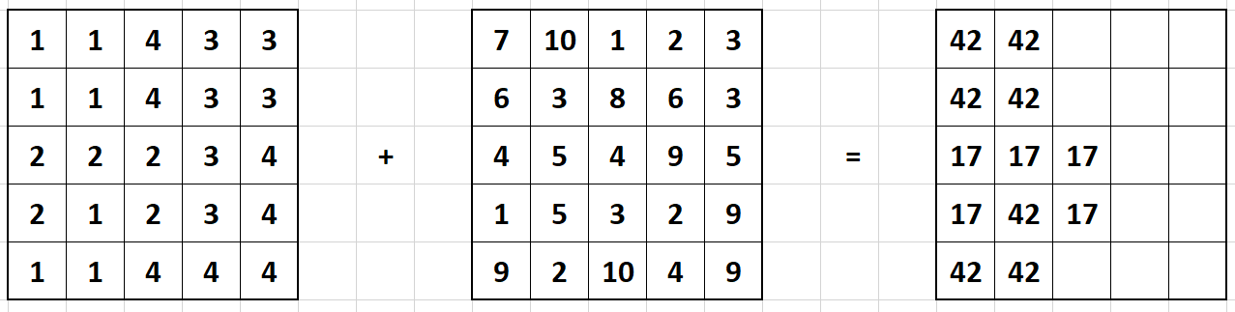

Slide 20
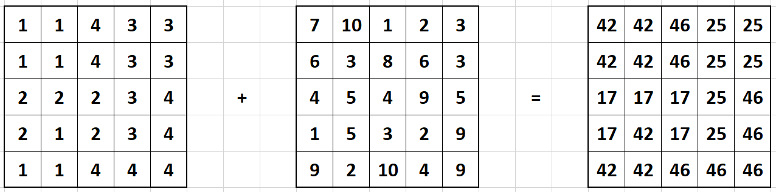

Slide 21
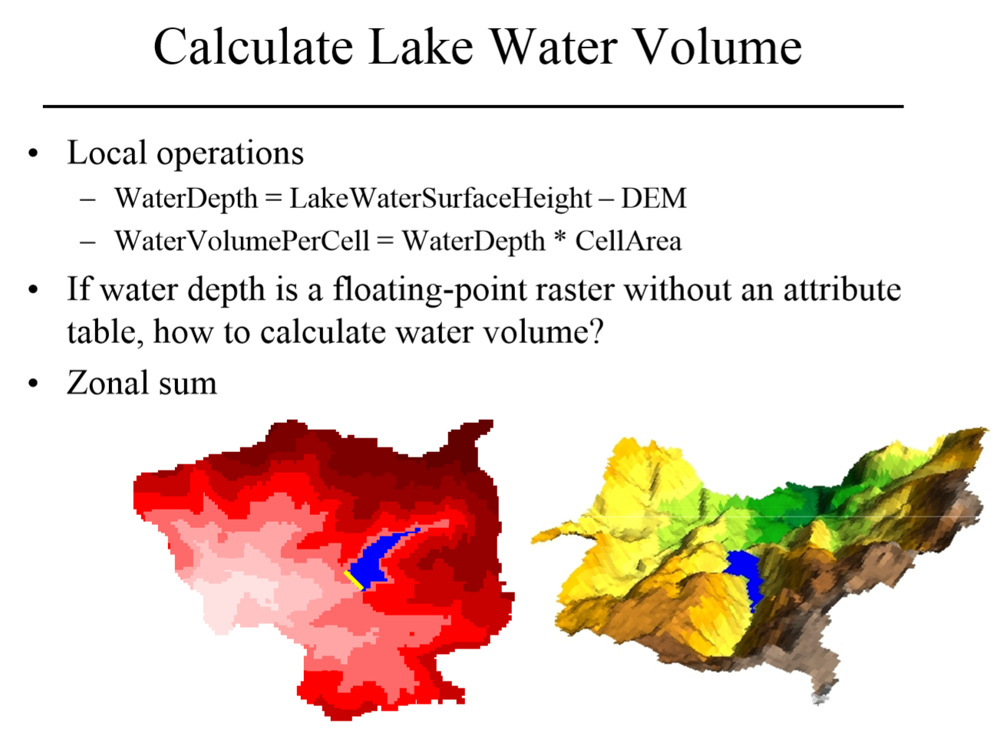

Slide 22
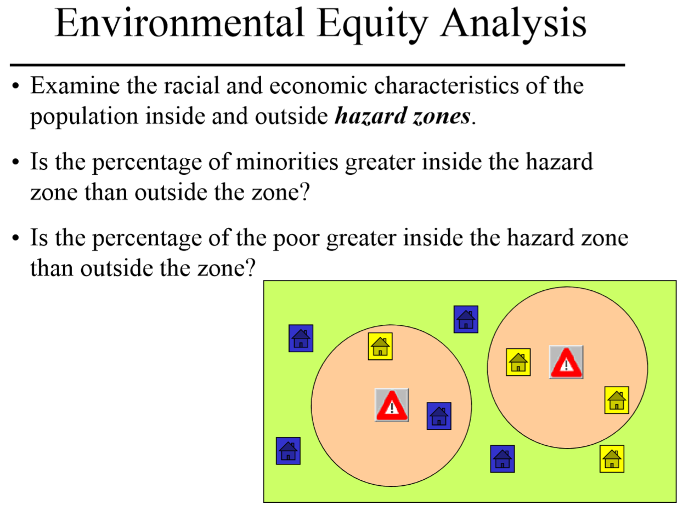

Slide 23
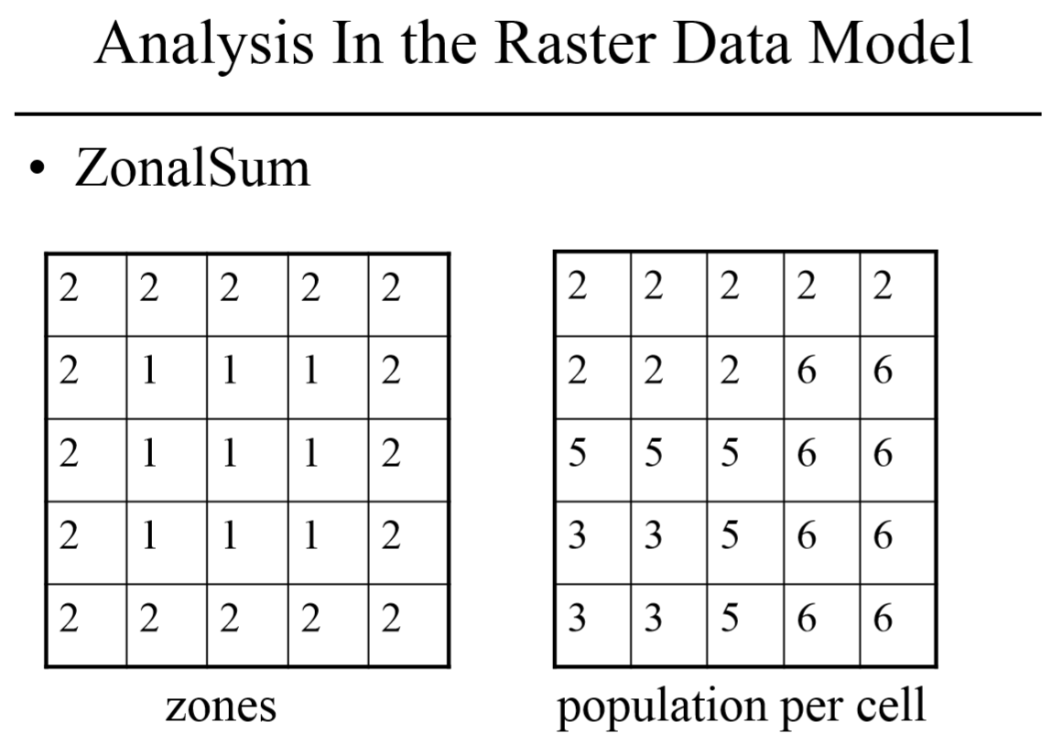

Slide 24
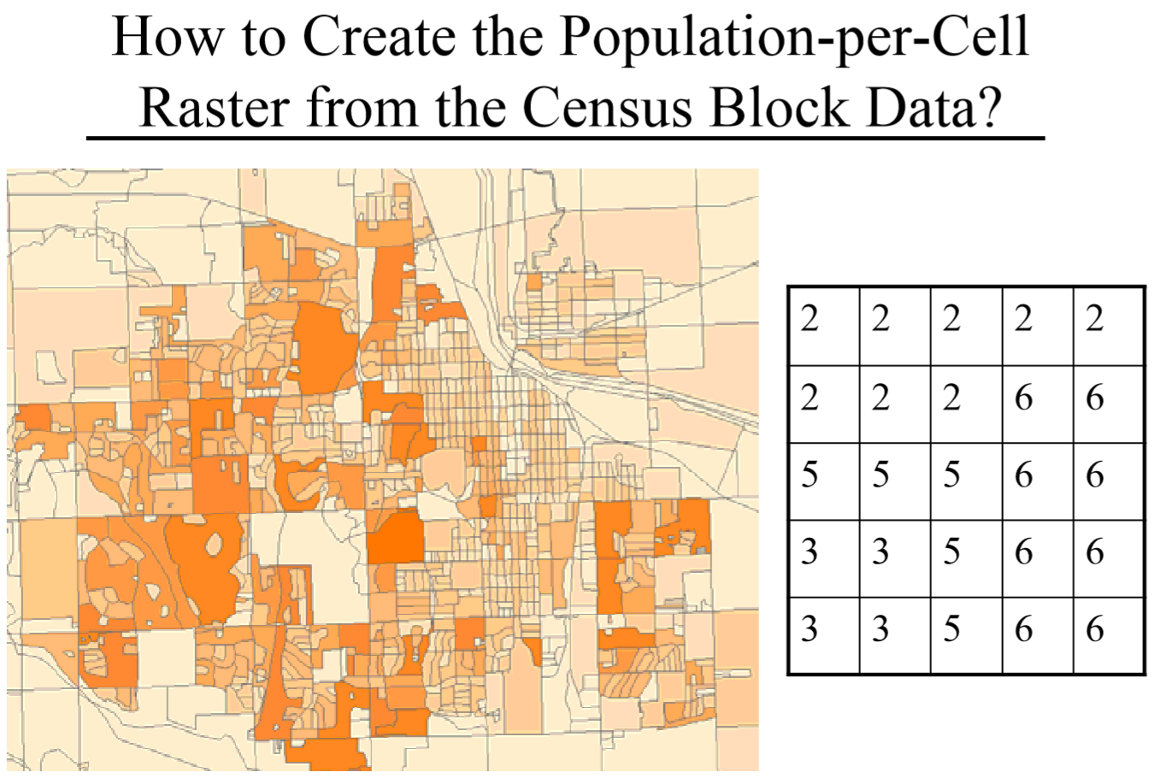

Slide 25
Can we just run feature to raster?
Population is a variable which implies spatial extent!

Slide 26
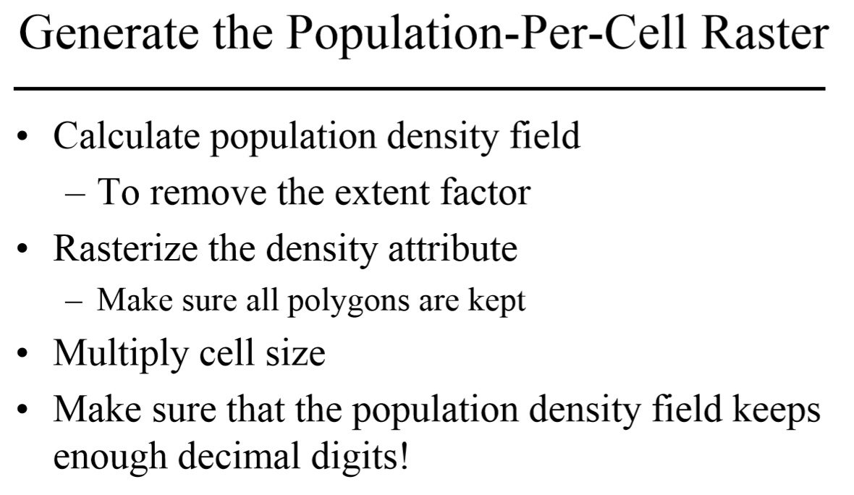

Slide 27
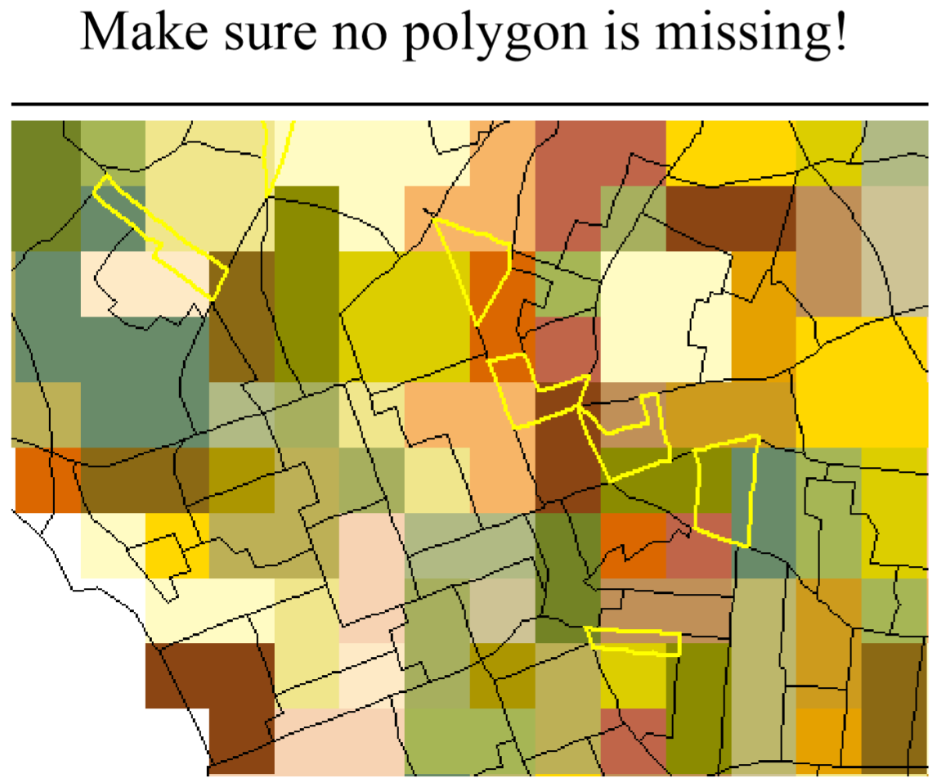

Slide 28
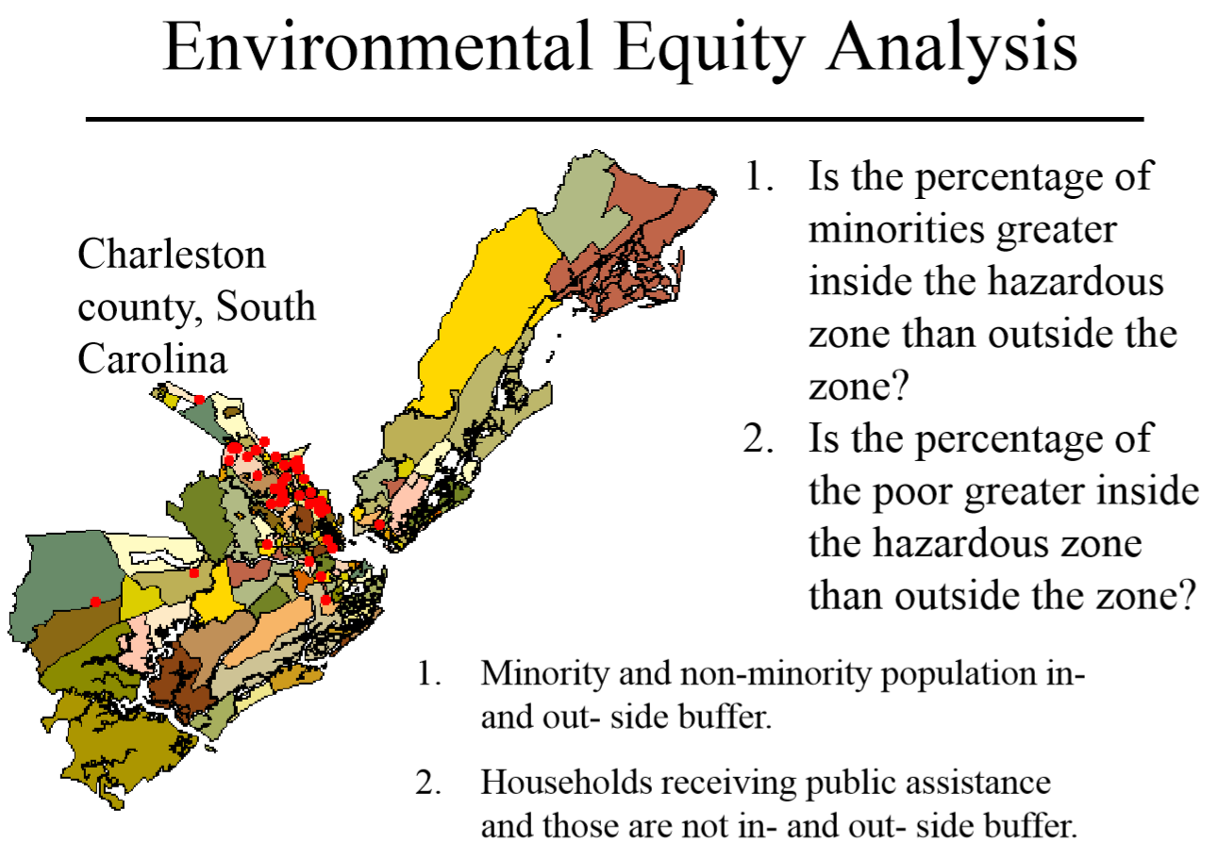

Slide 29
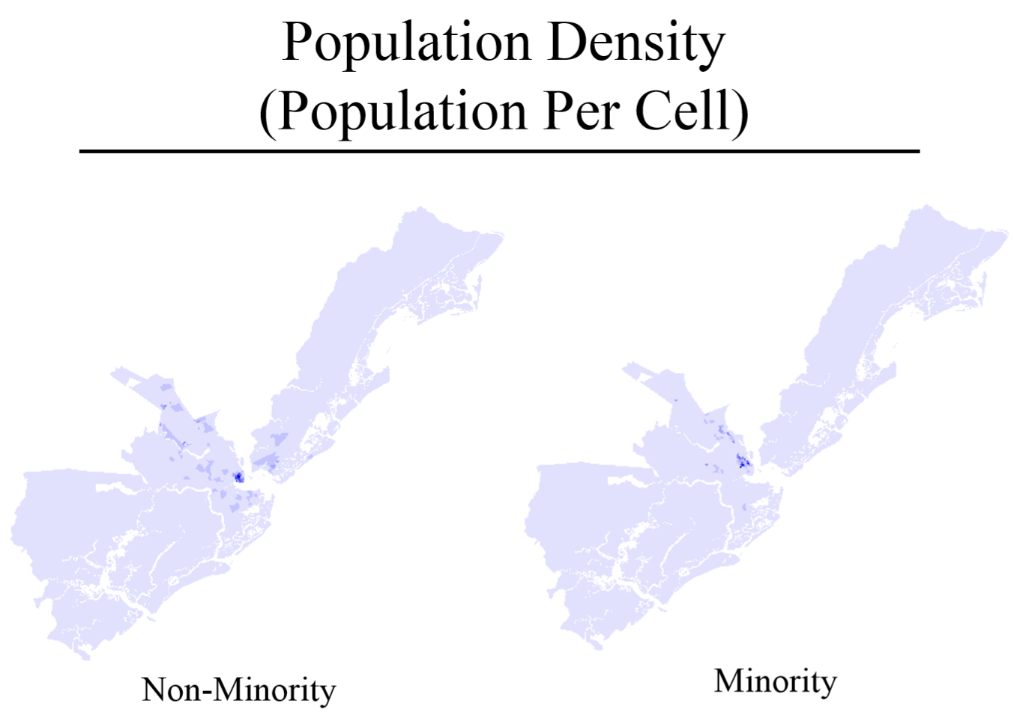

Slide 30
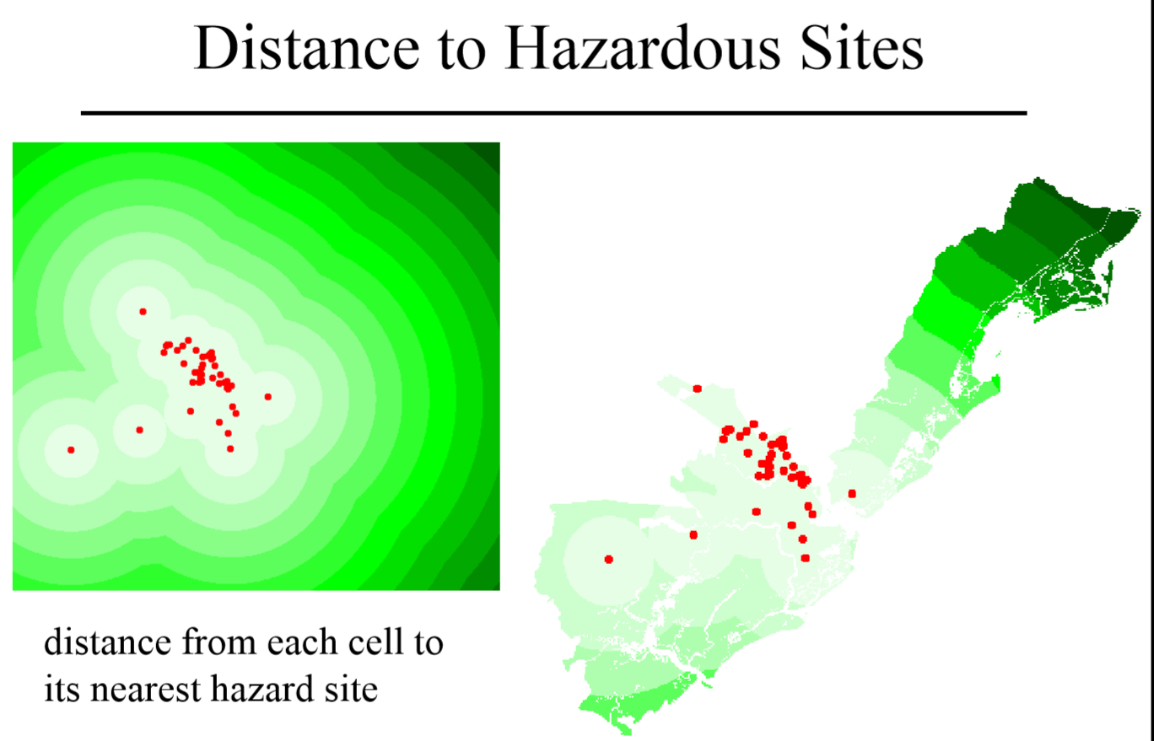

Slide 31
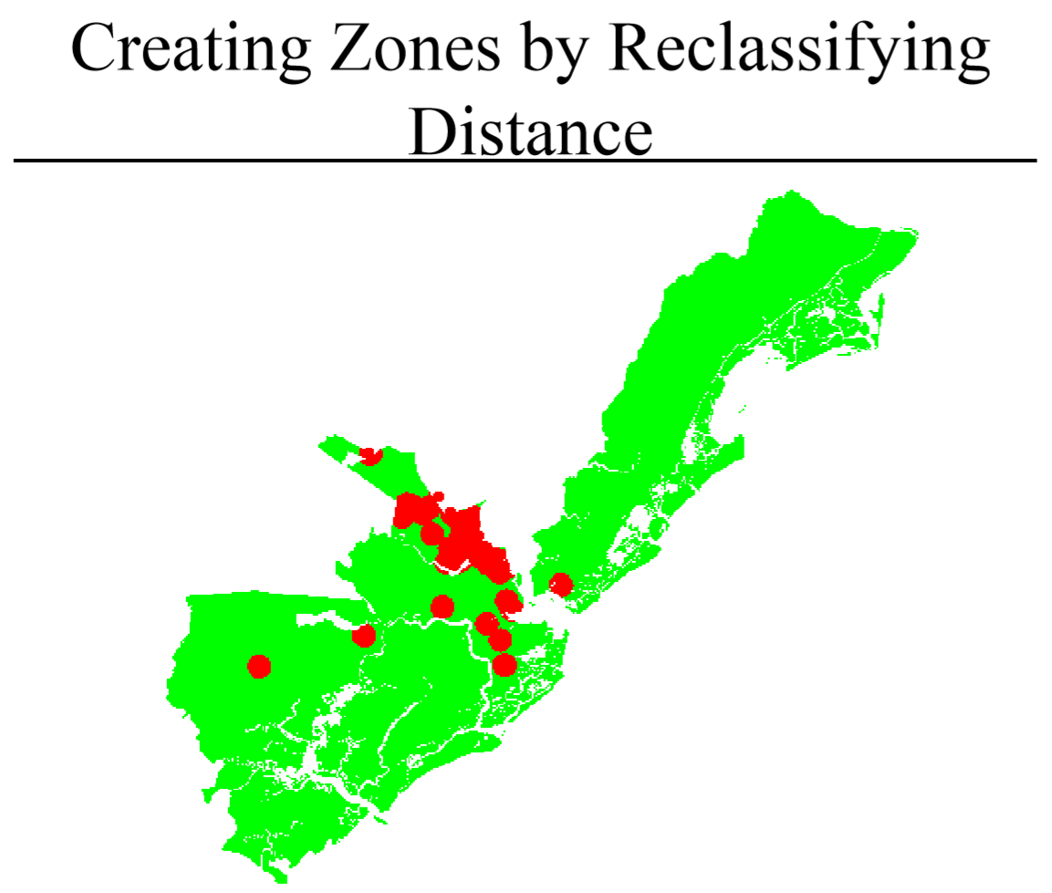

Slide 32
ZONES
Input
Output

Slide 33
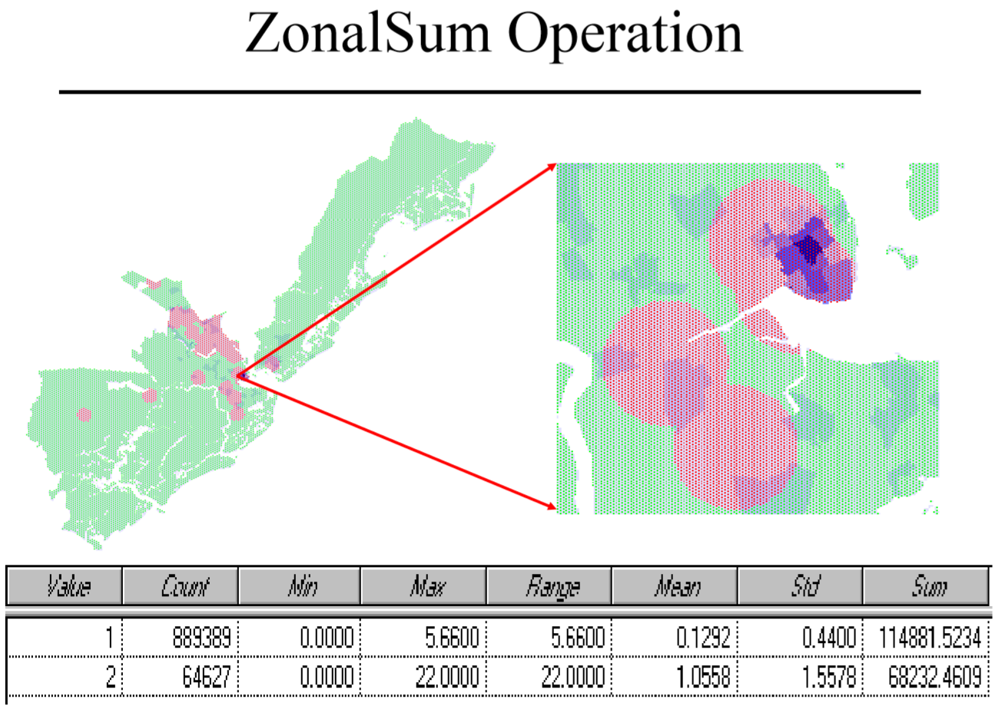

Slide 34
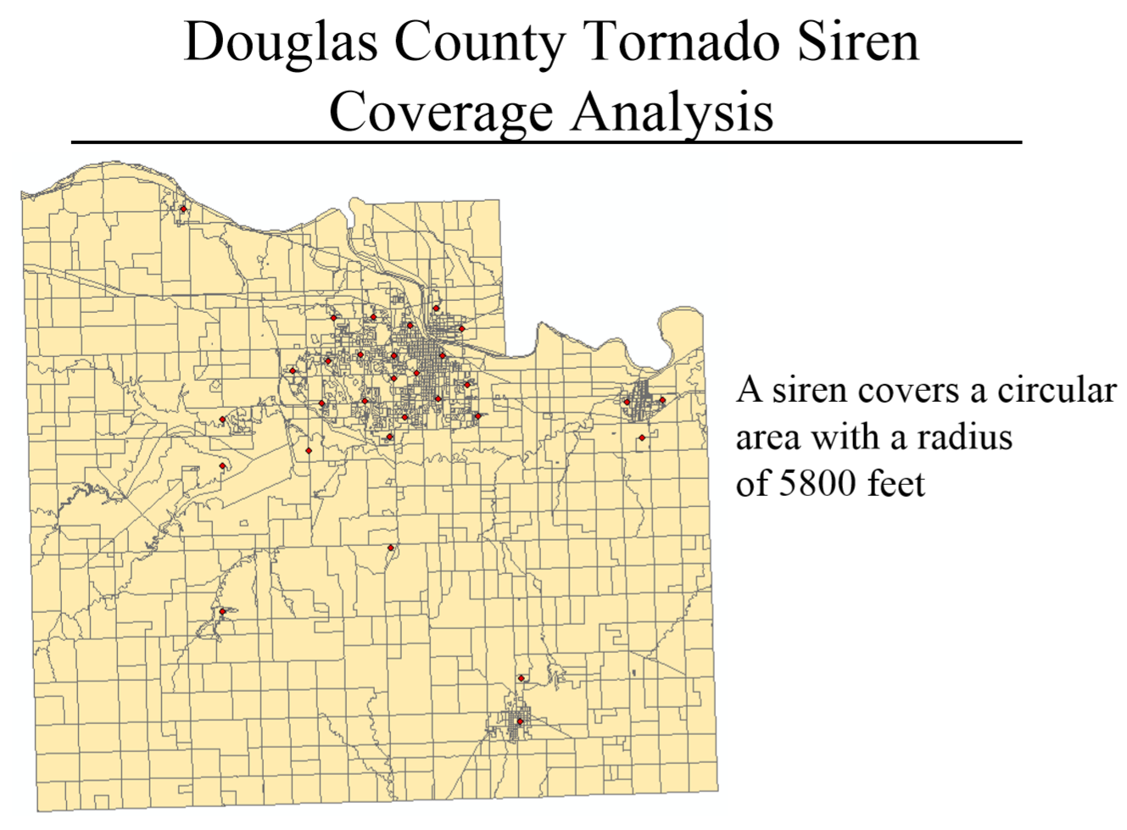

Slide 35
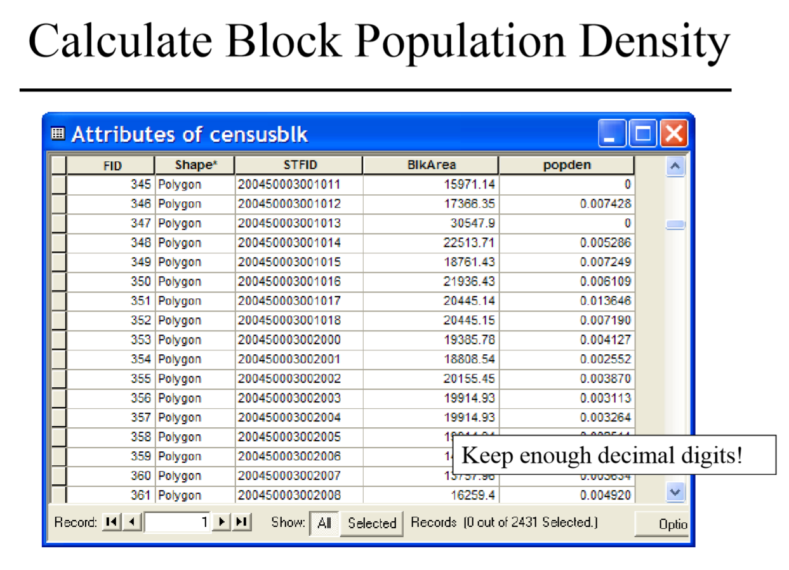

Slide 36
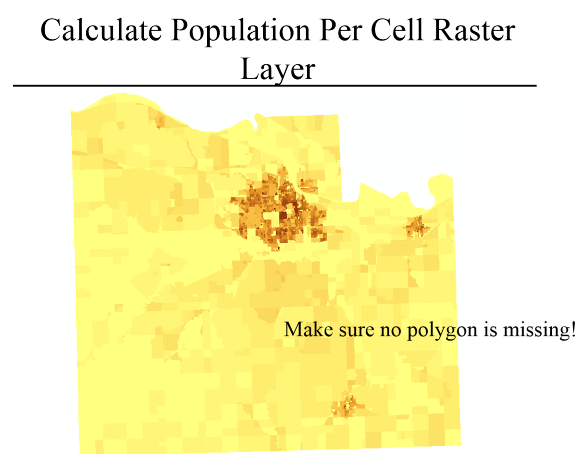

Slide 37
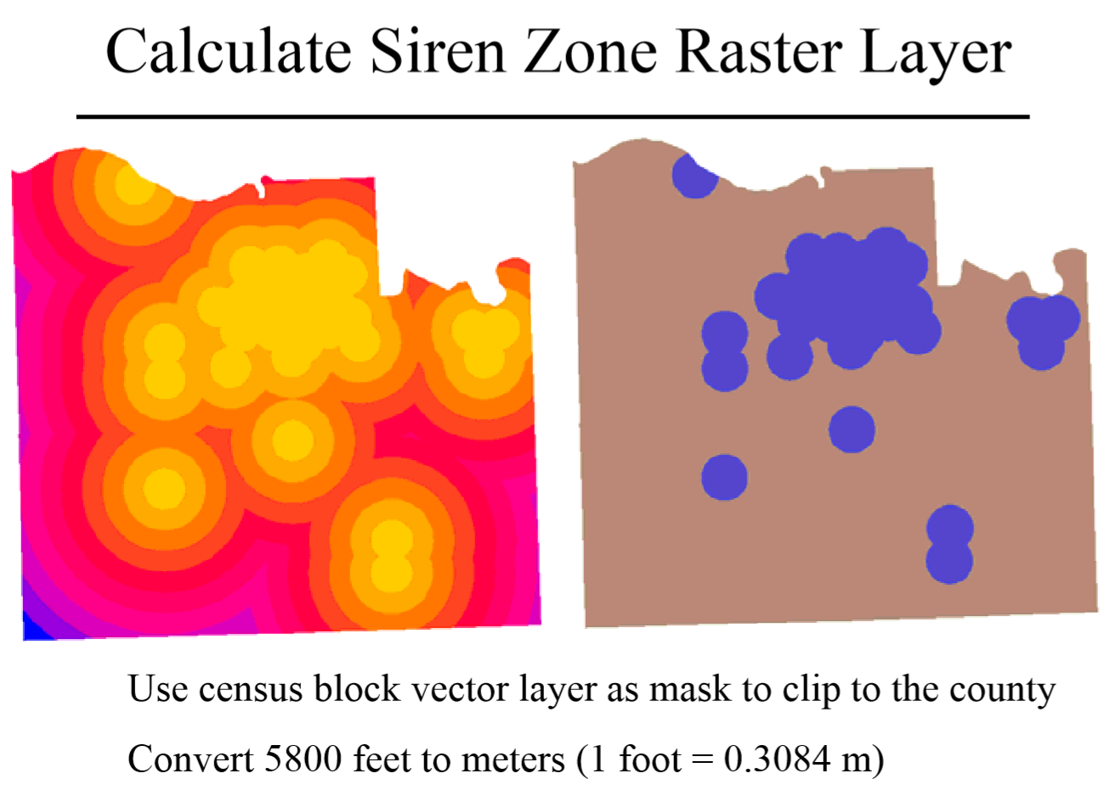

Slide 38
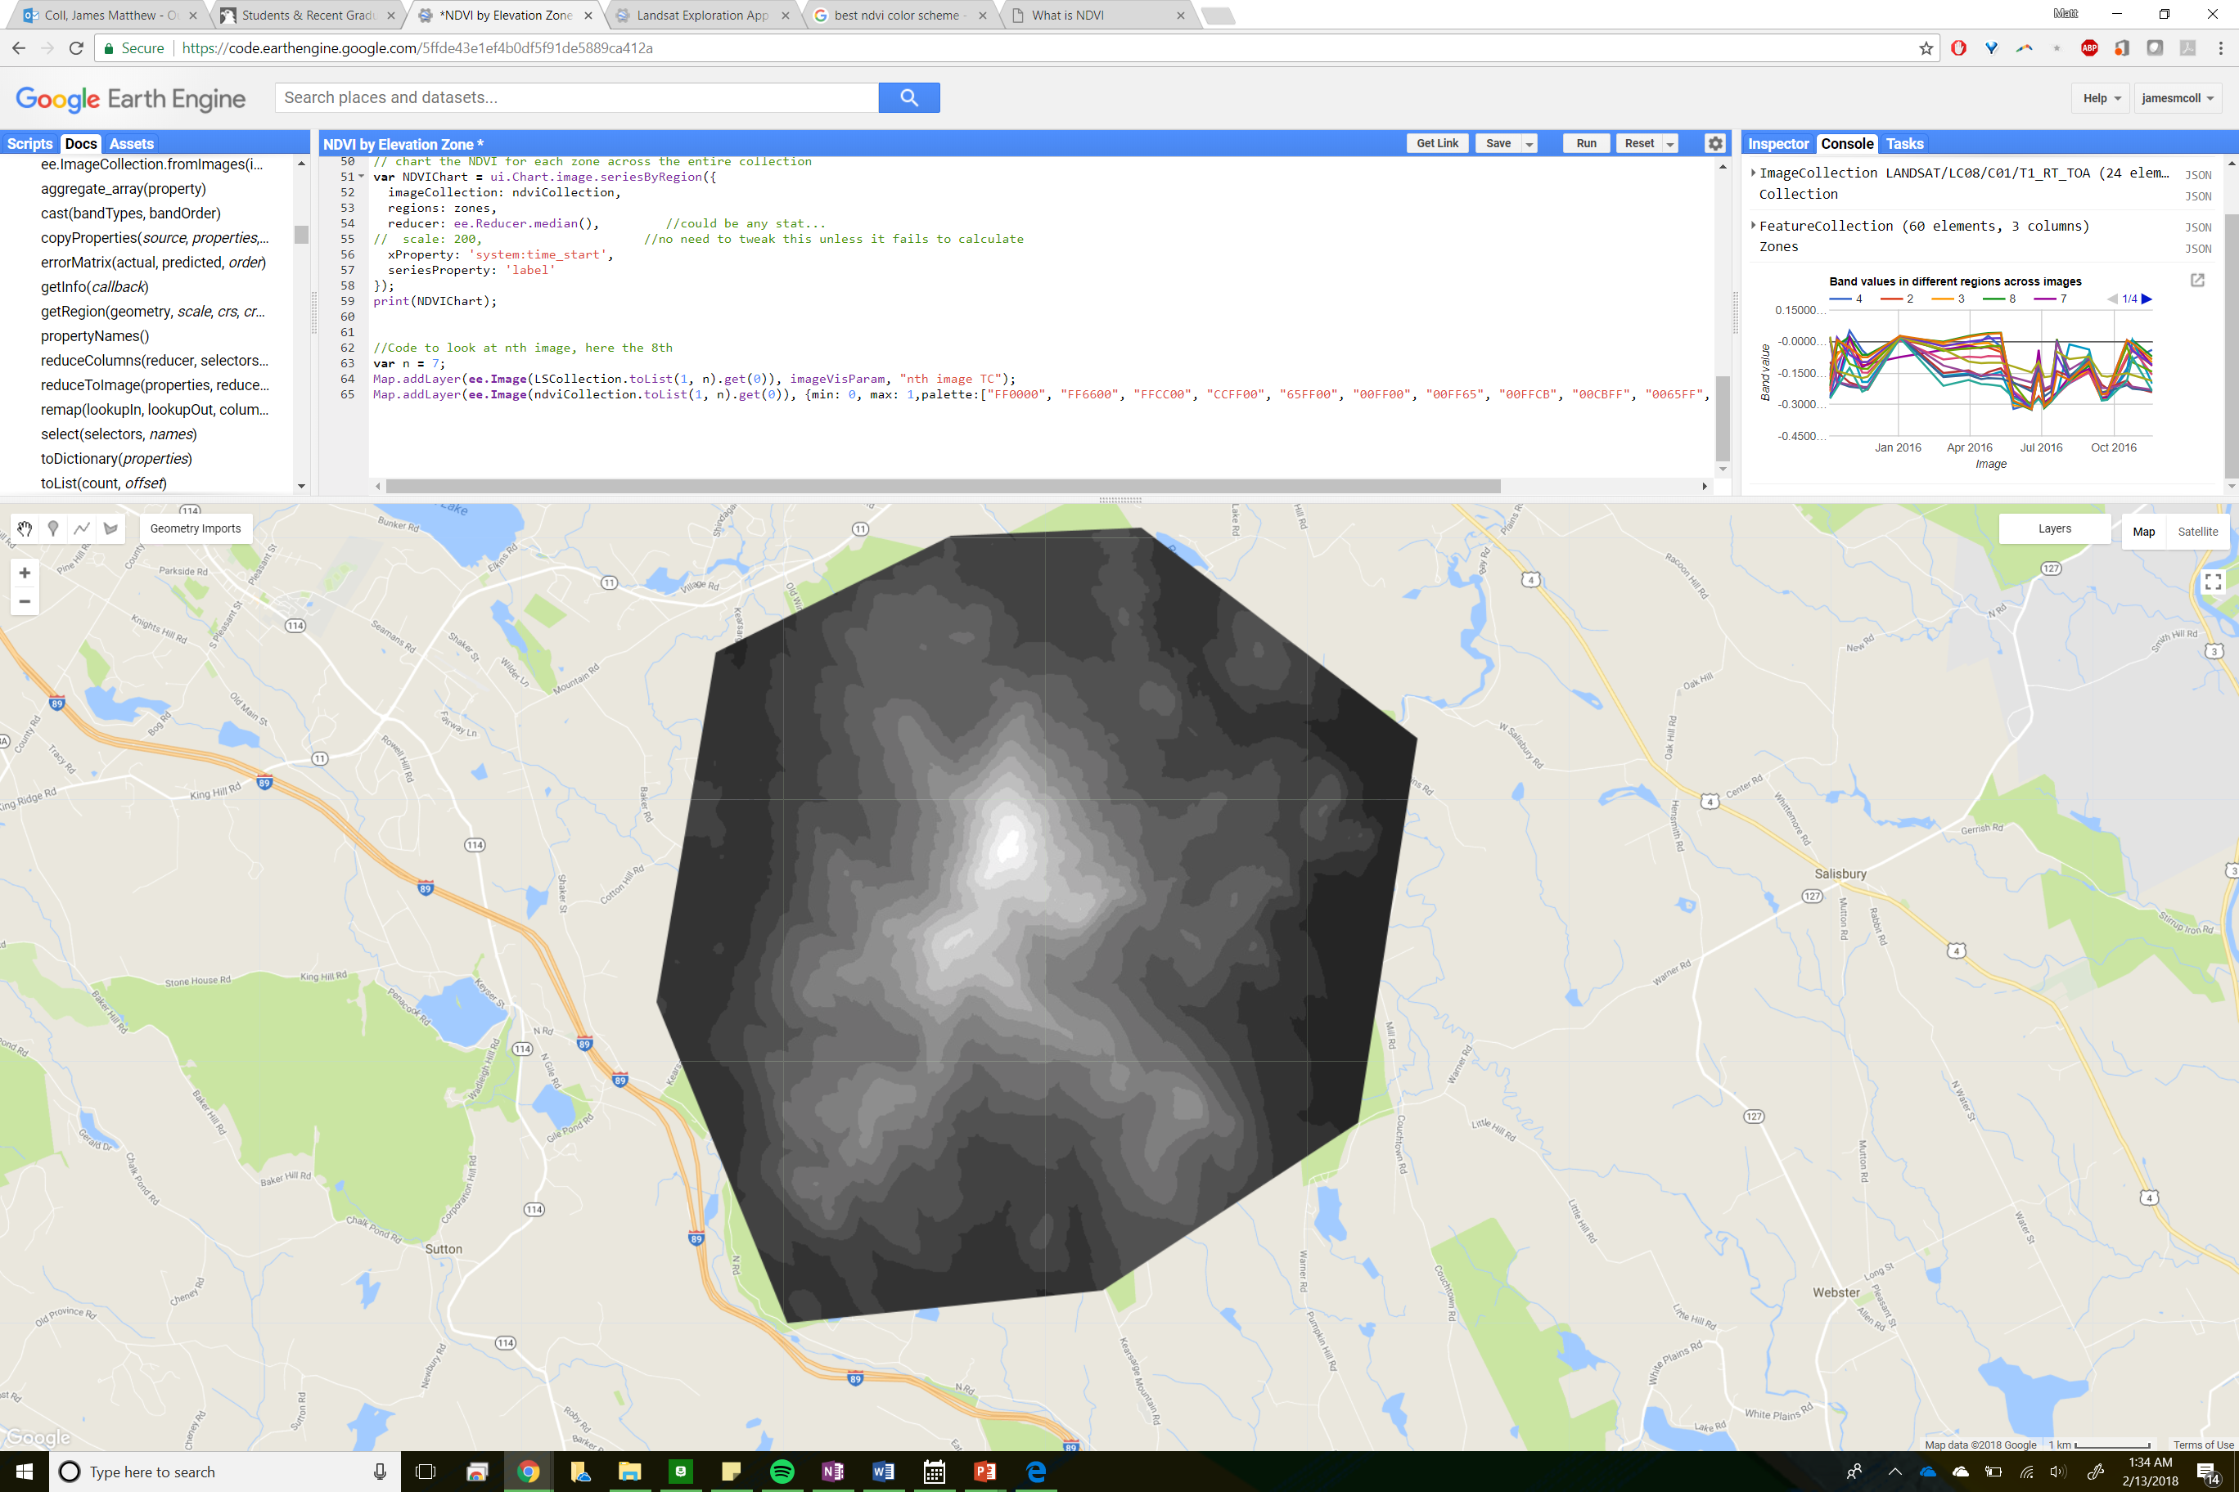
Notes:
https://code.earthengine.google.com/5ffde43e1ef4b0df5f91de5889ca412a

Slide 39
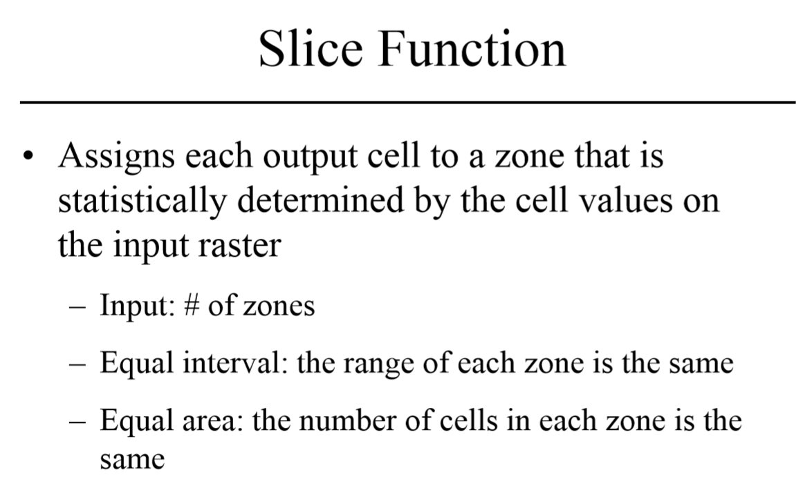

Slide 41
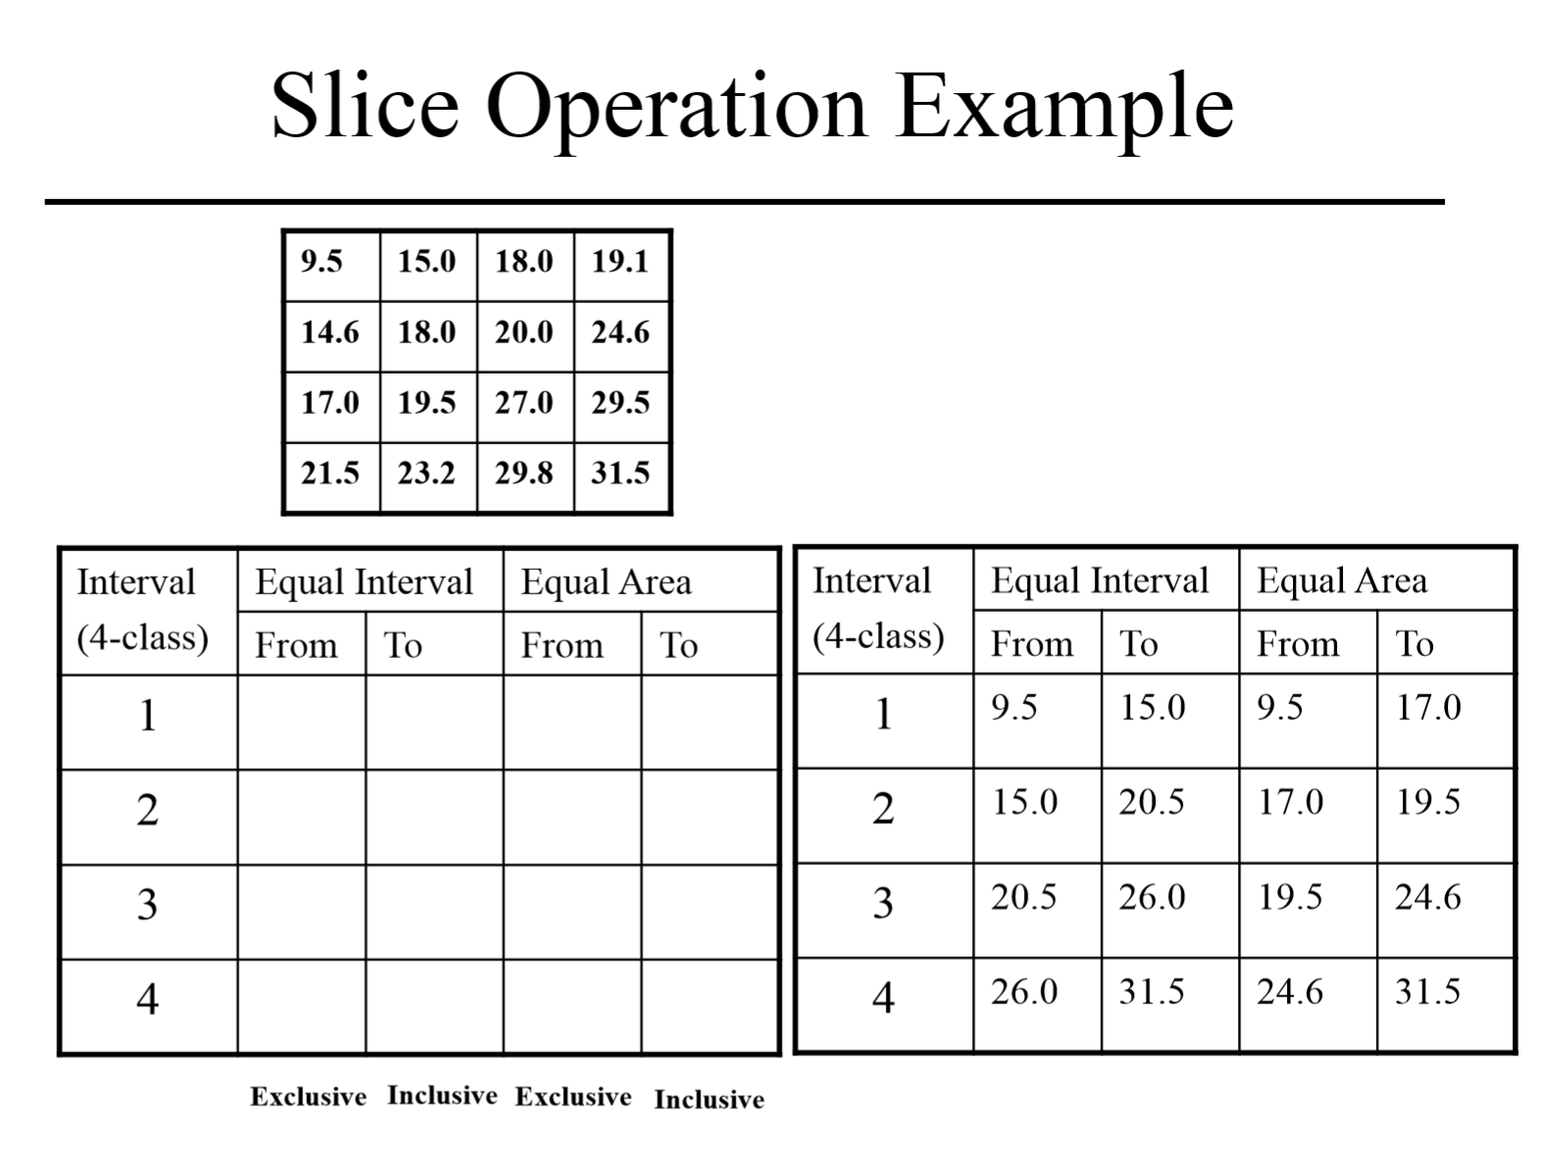

Slide 42
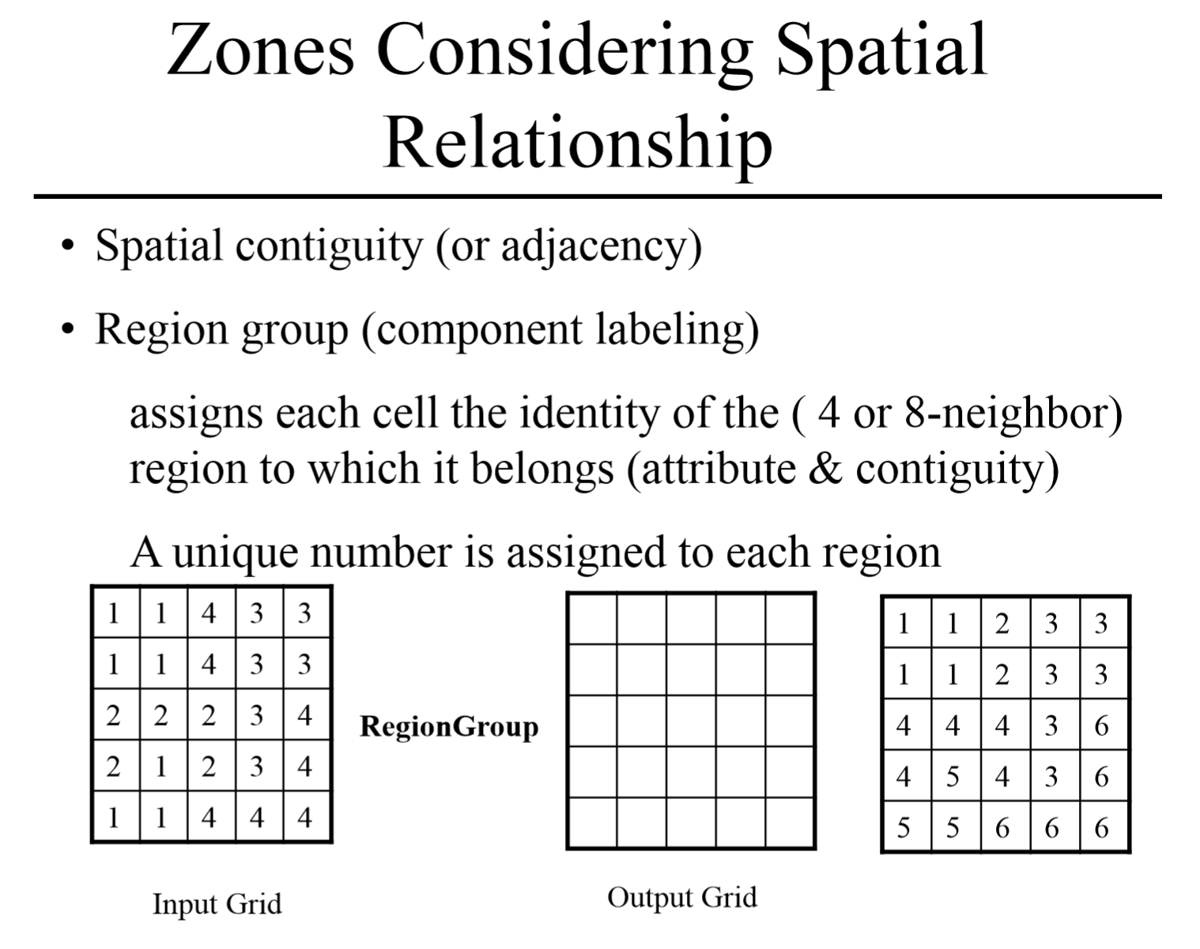

Slide 43
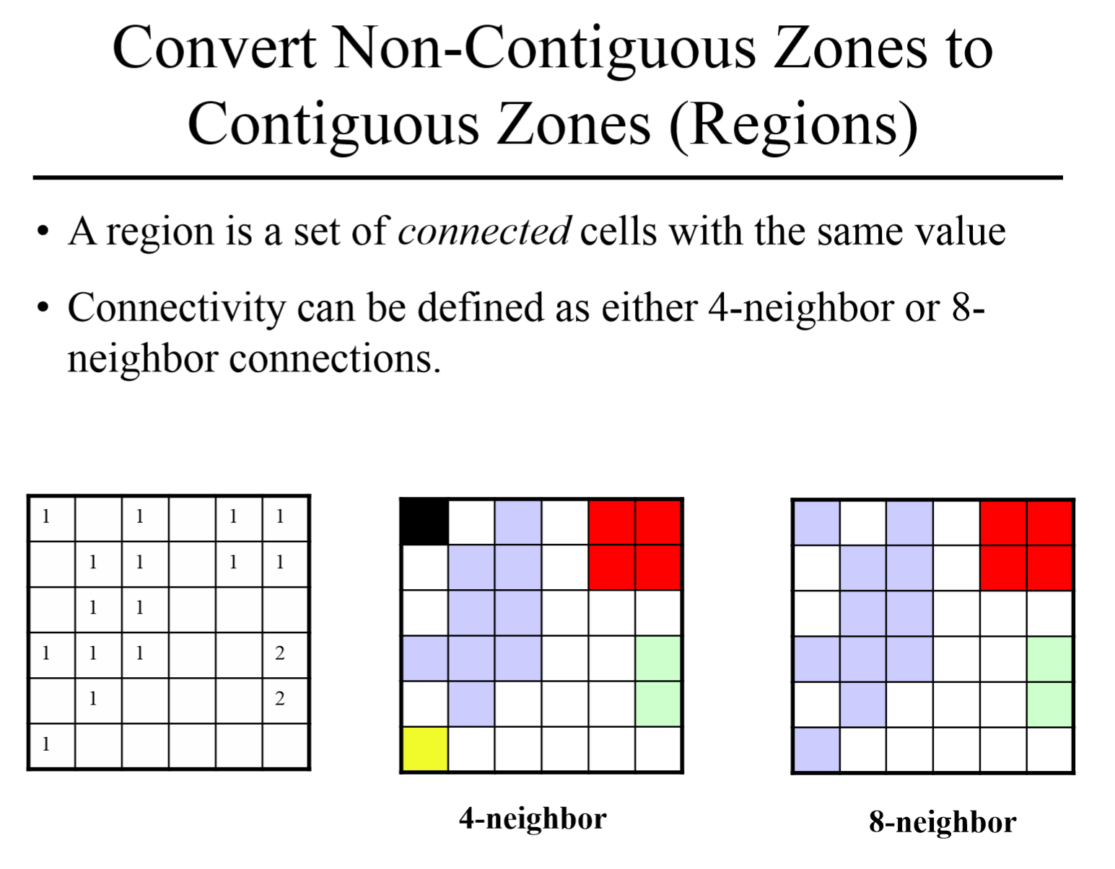

Slide 44
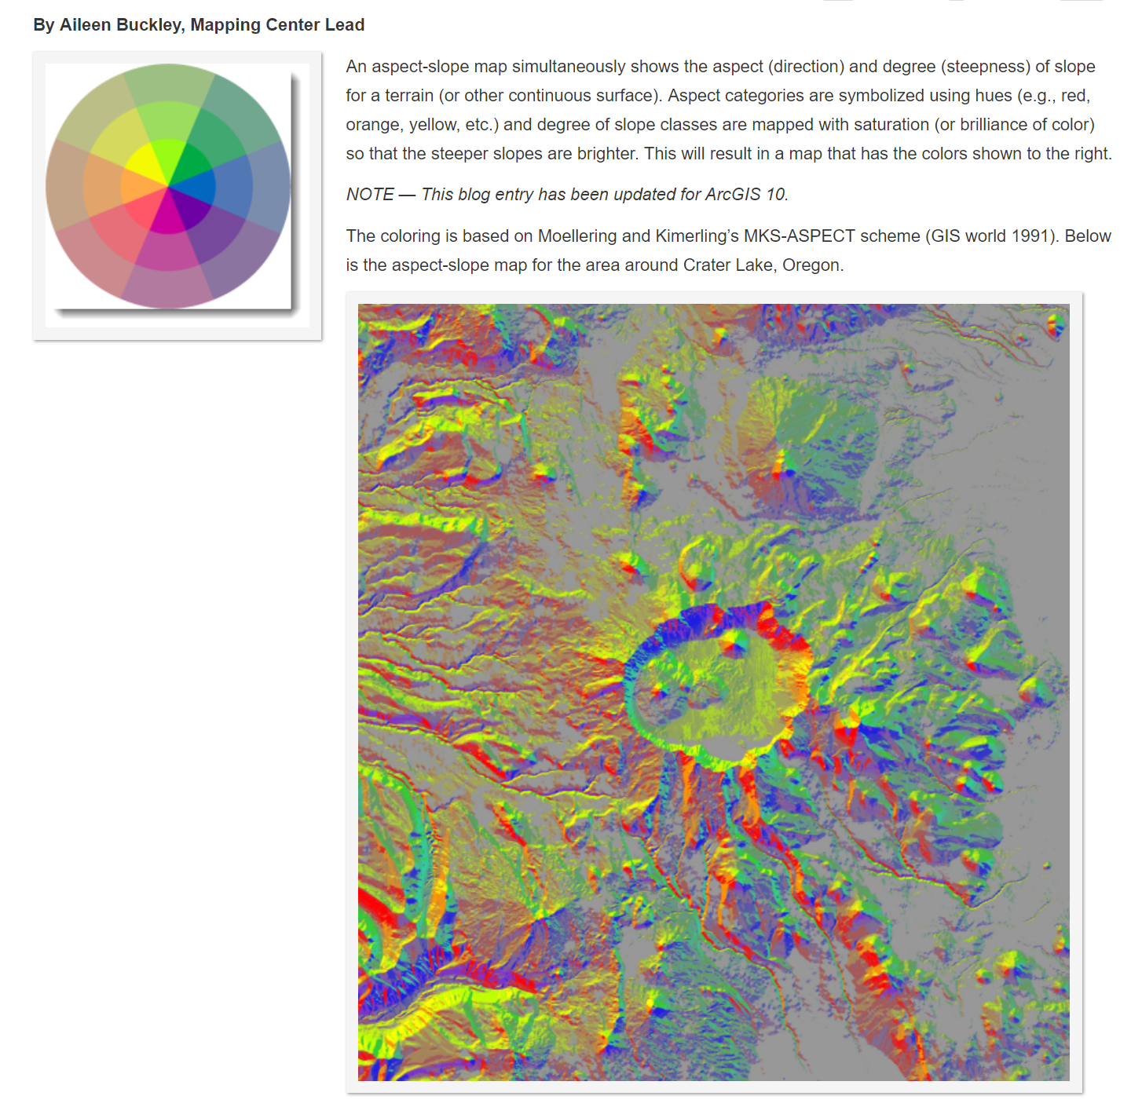

Slide 45
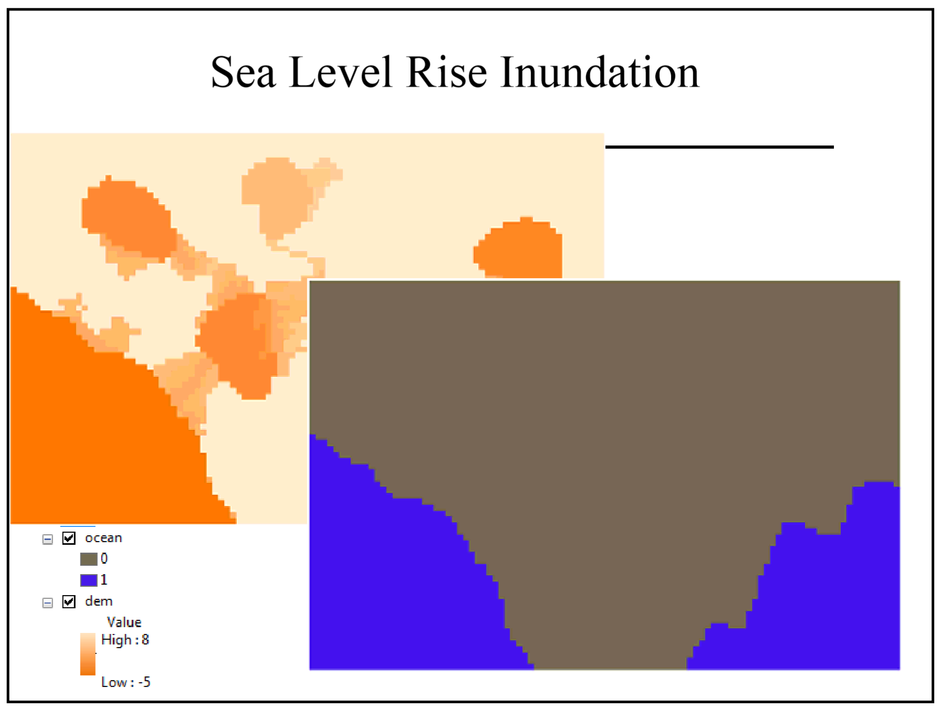

Slide 46
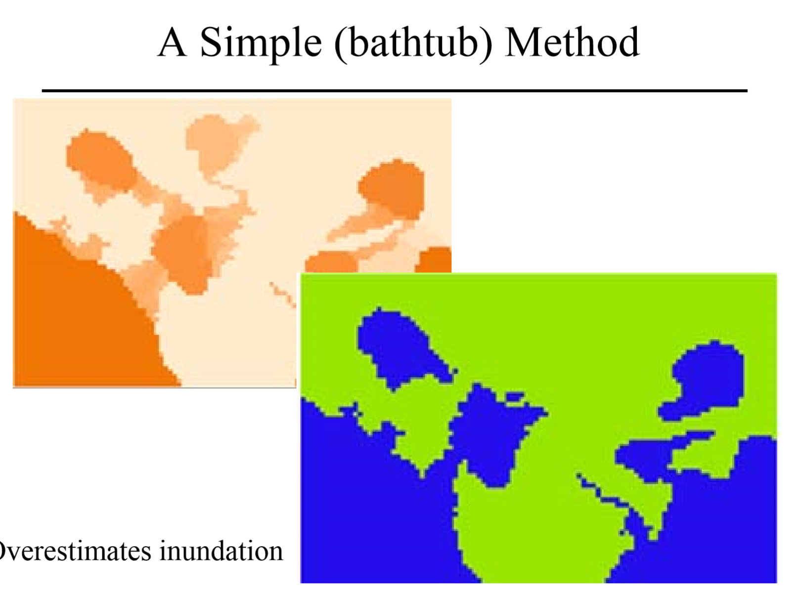

Slide 47
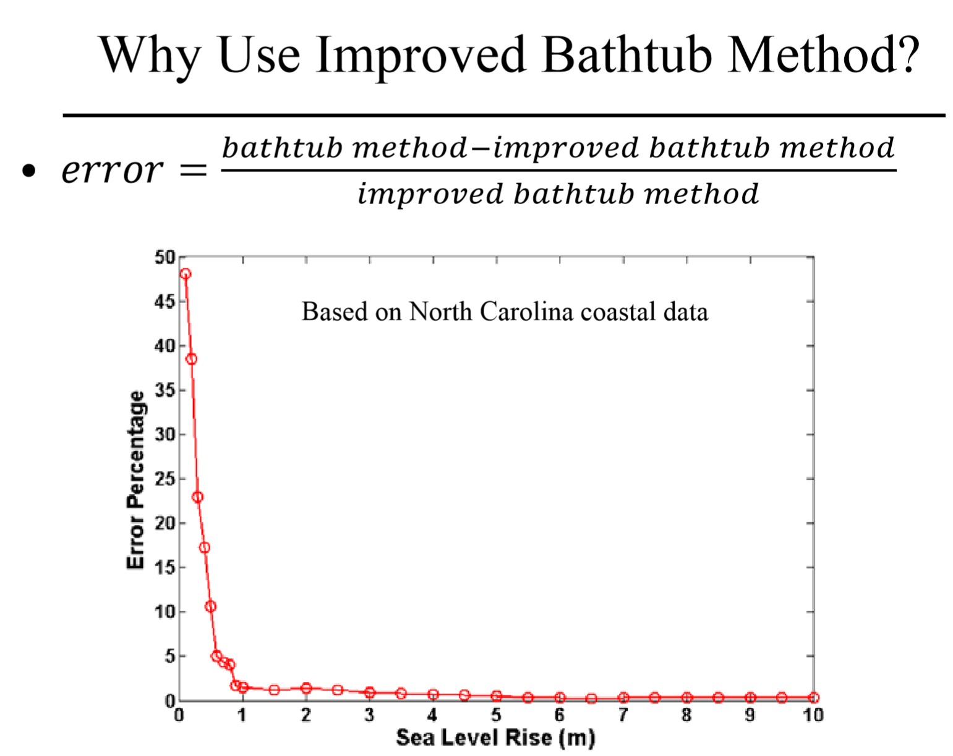

Slide 48
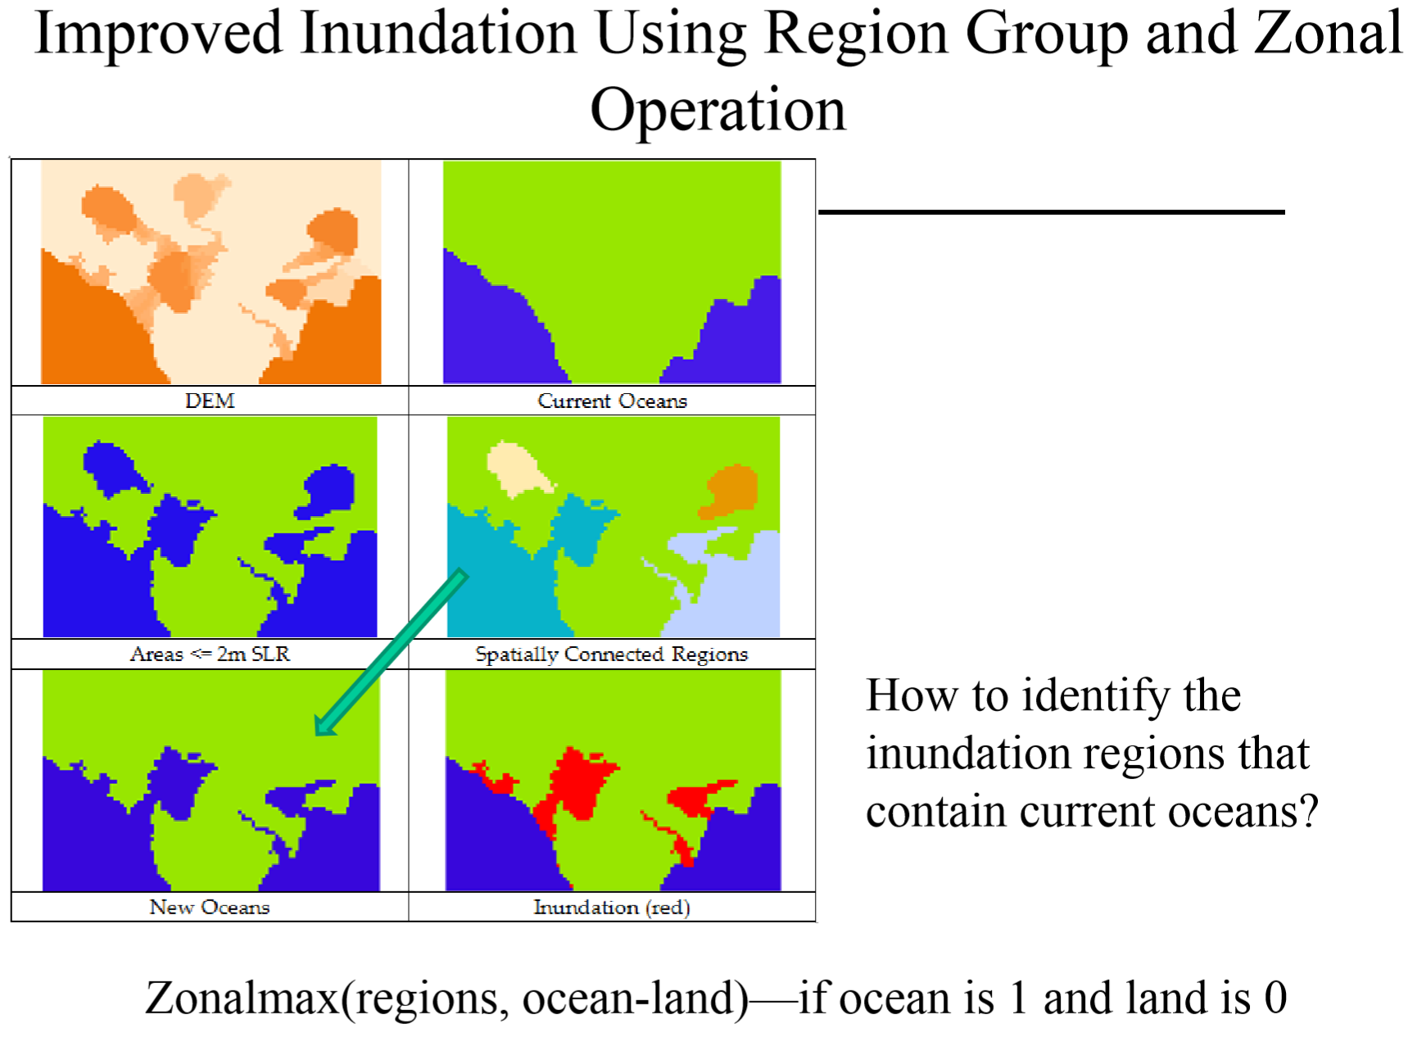

Slide 49
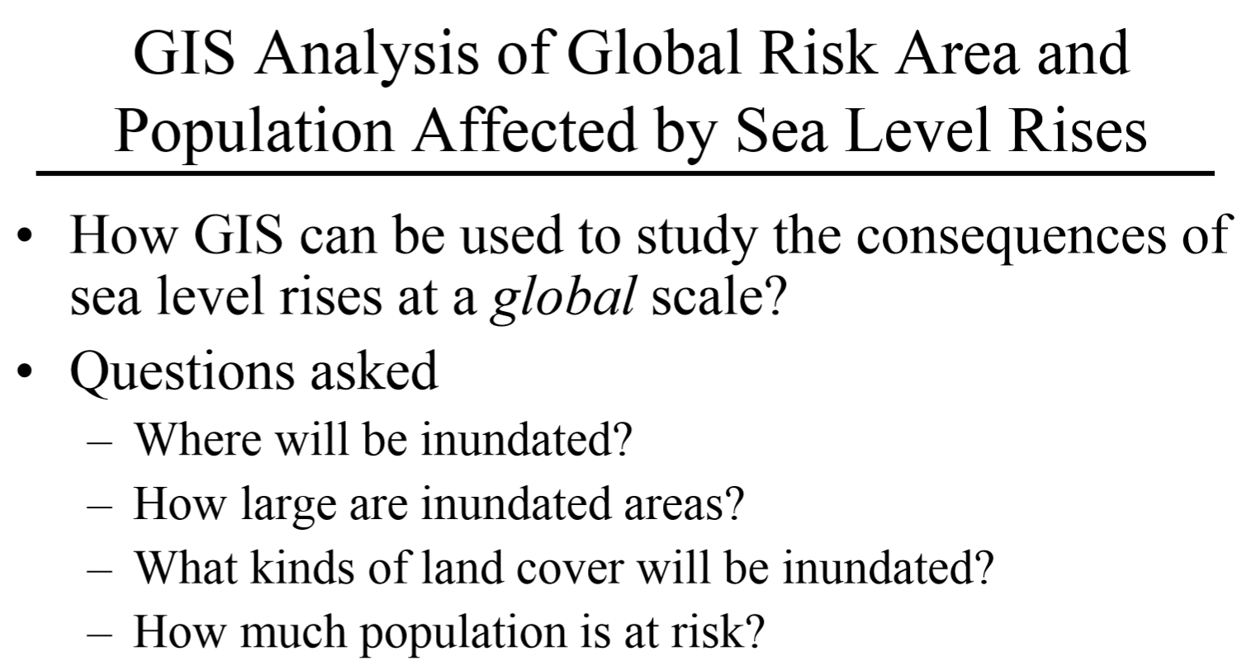

Slide 50
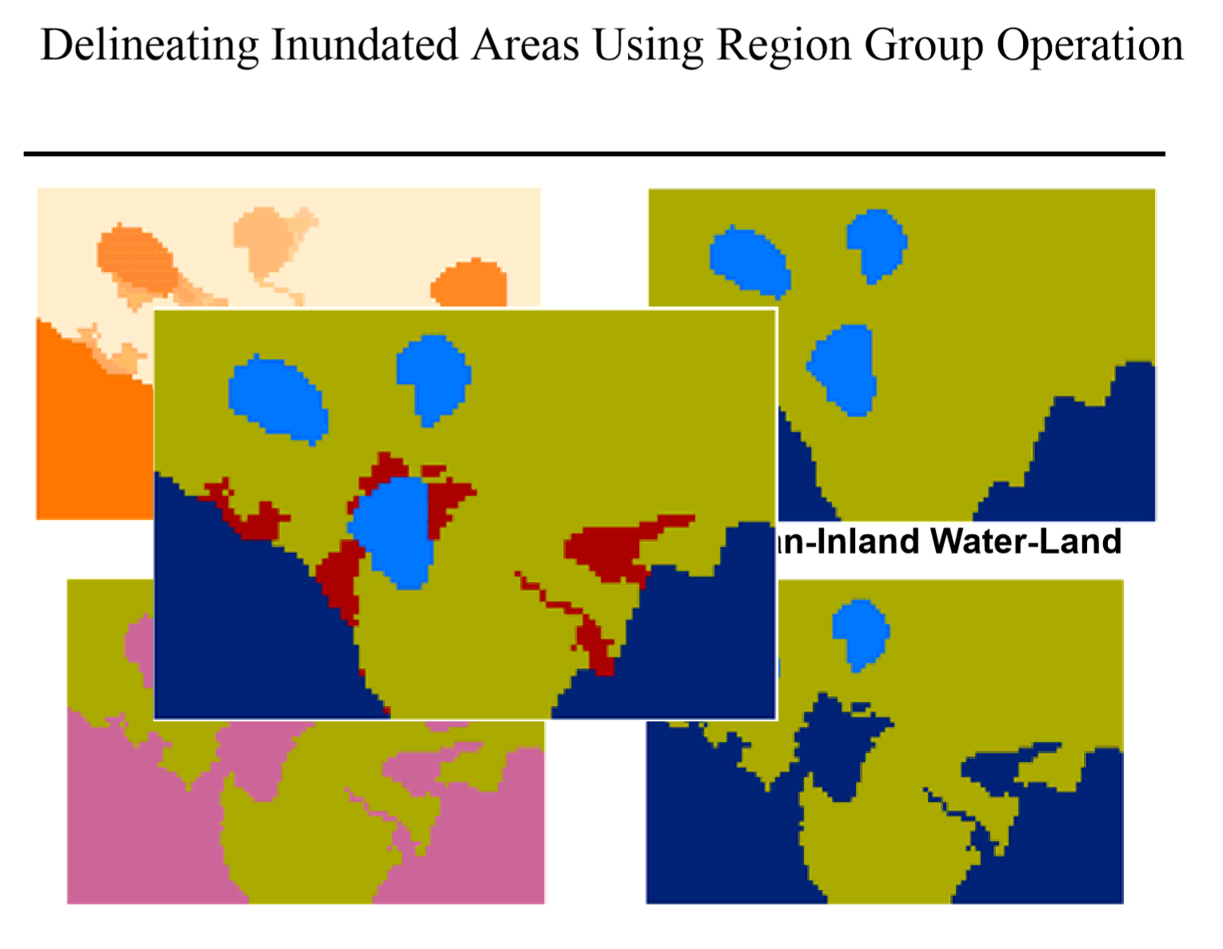

Slide 51
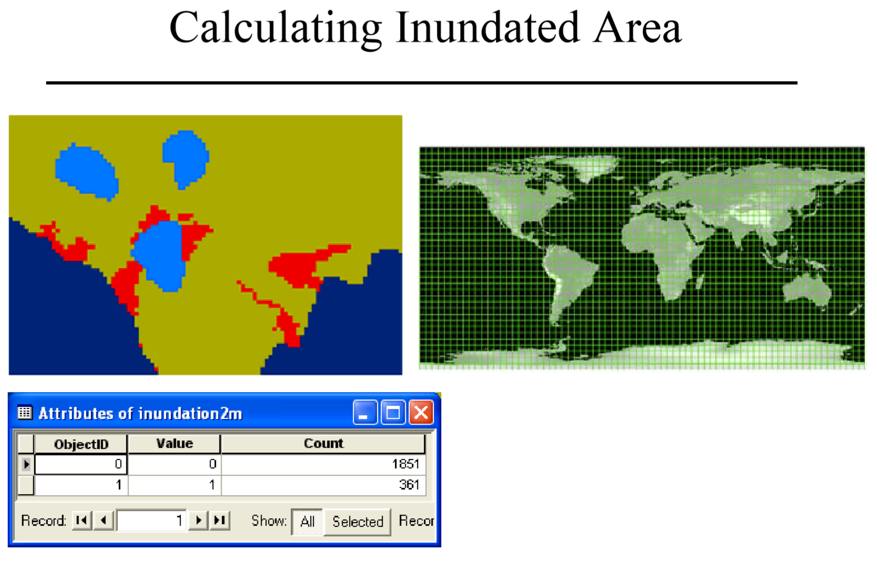

Slide 52
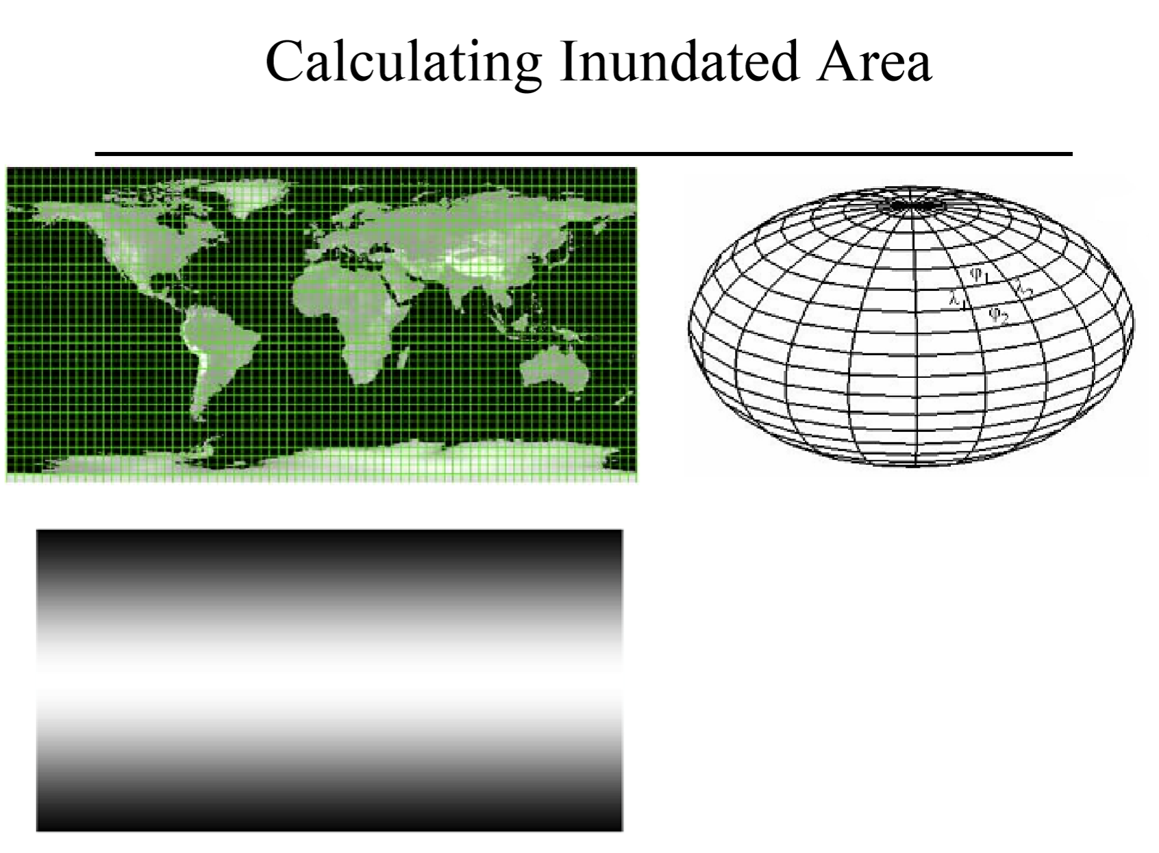

Slide 53
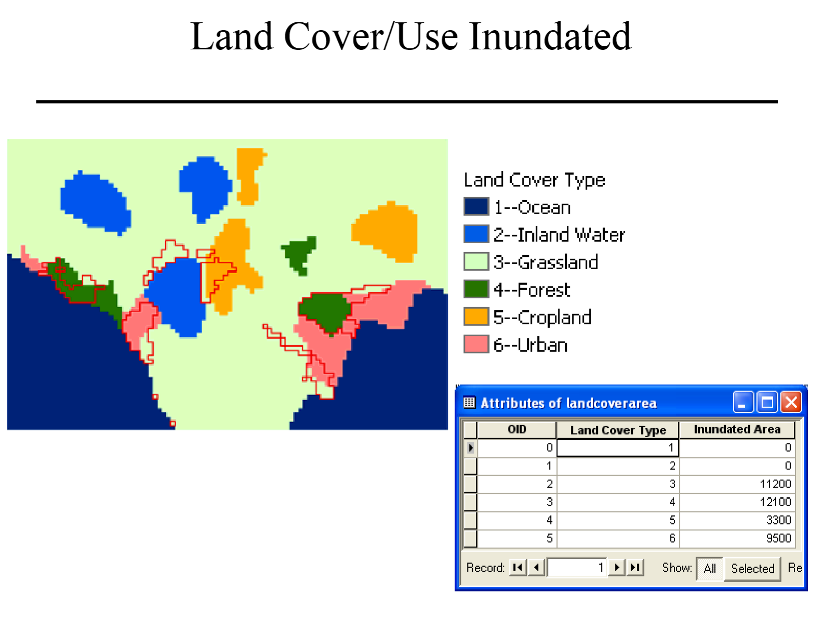

Slide 54
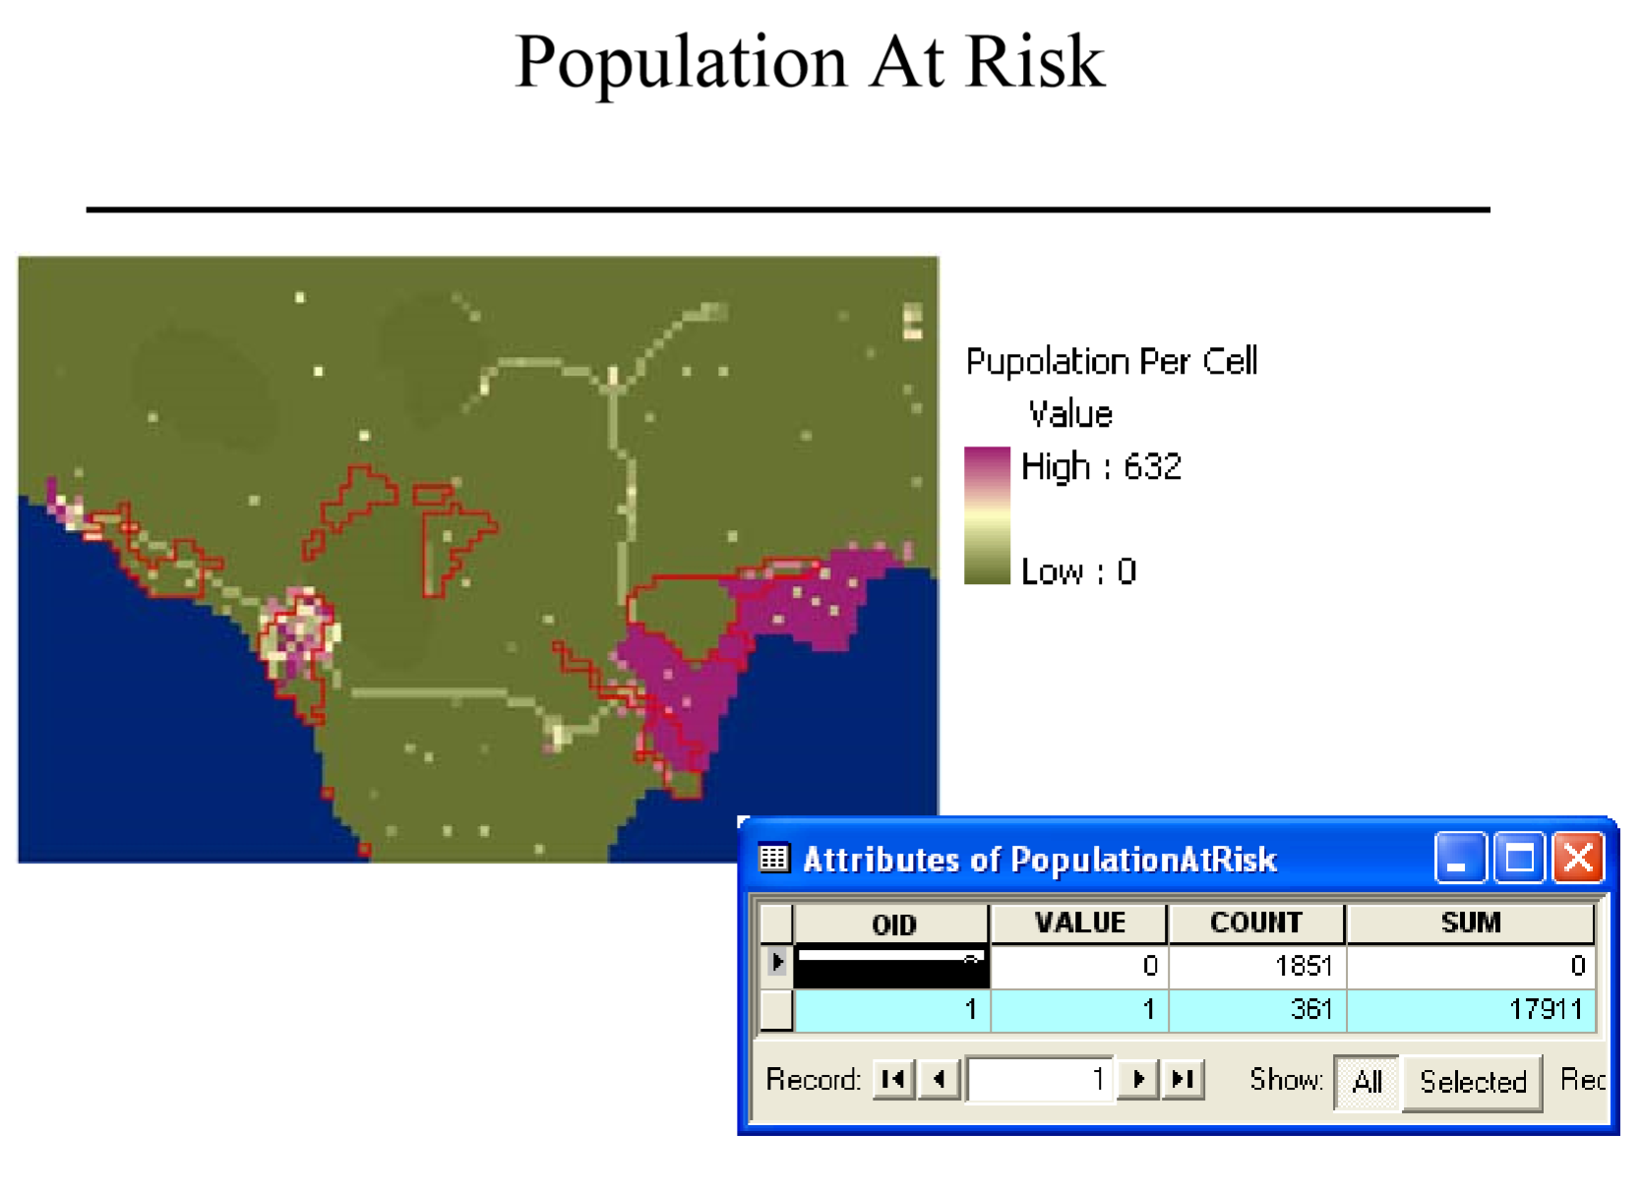

Slide 55
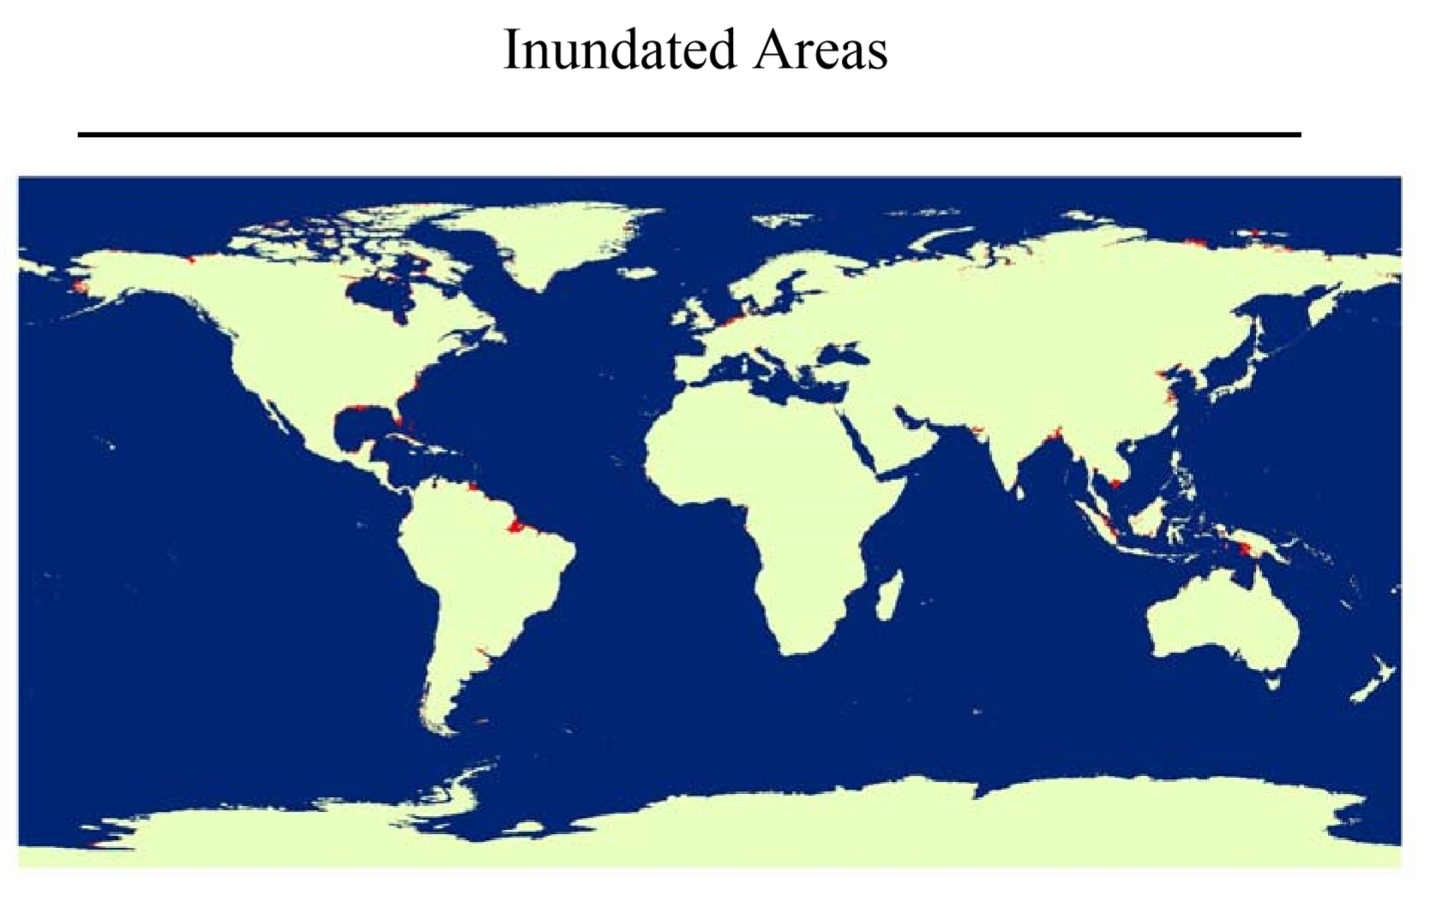

Slide 56
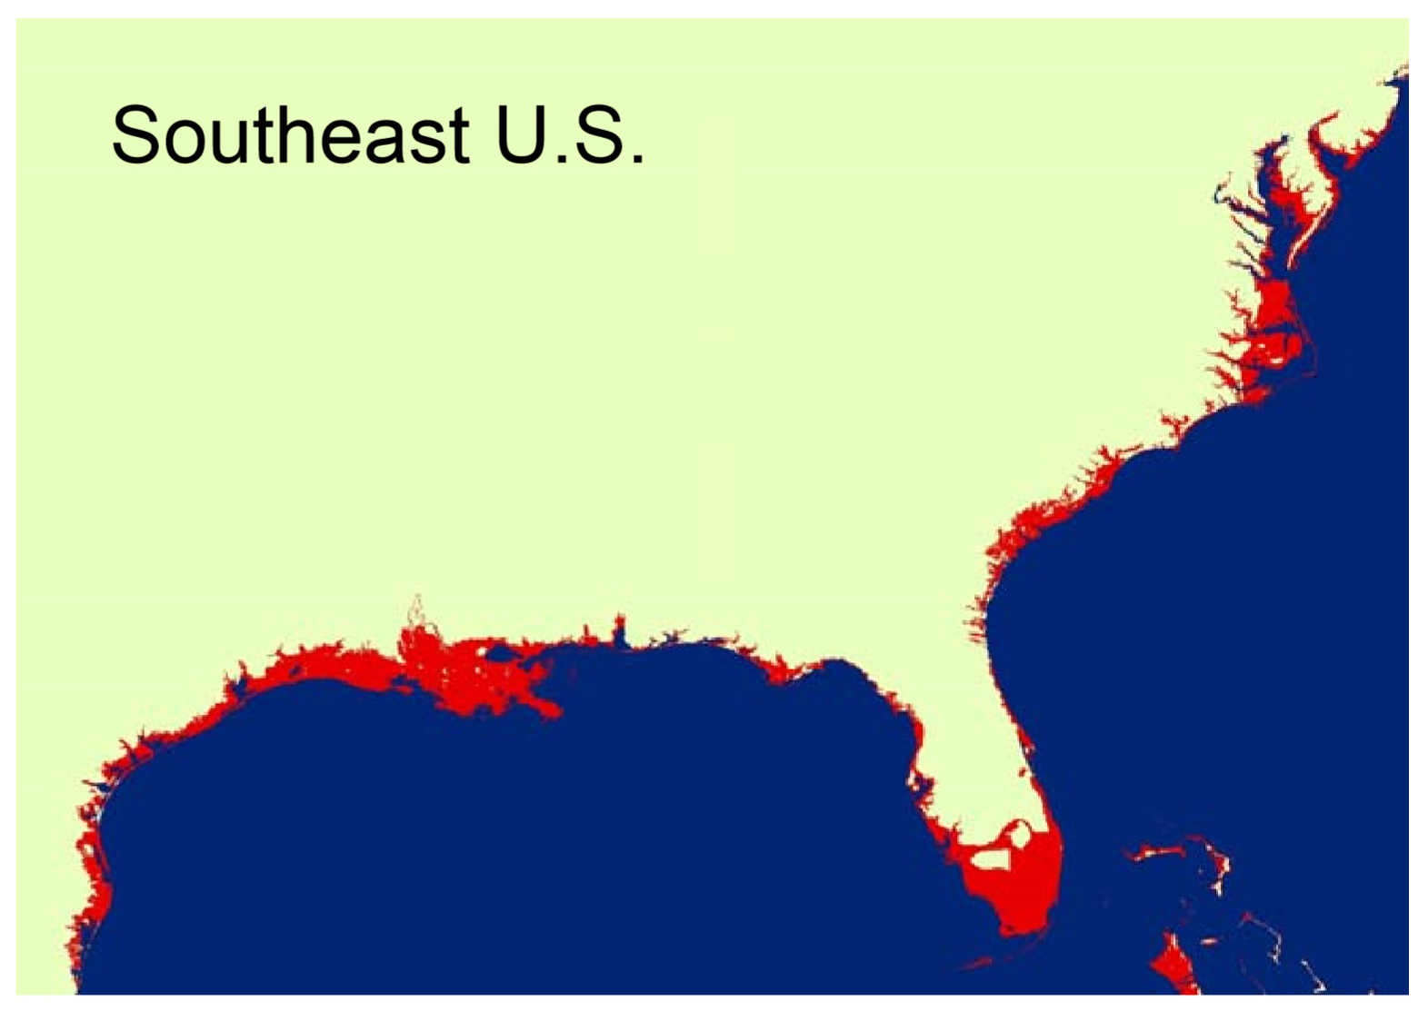

Slide 57
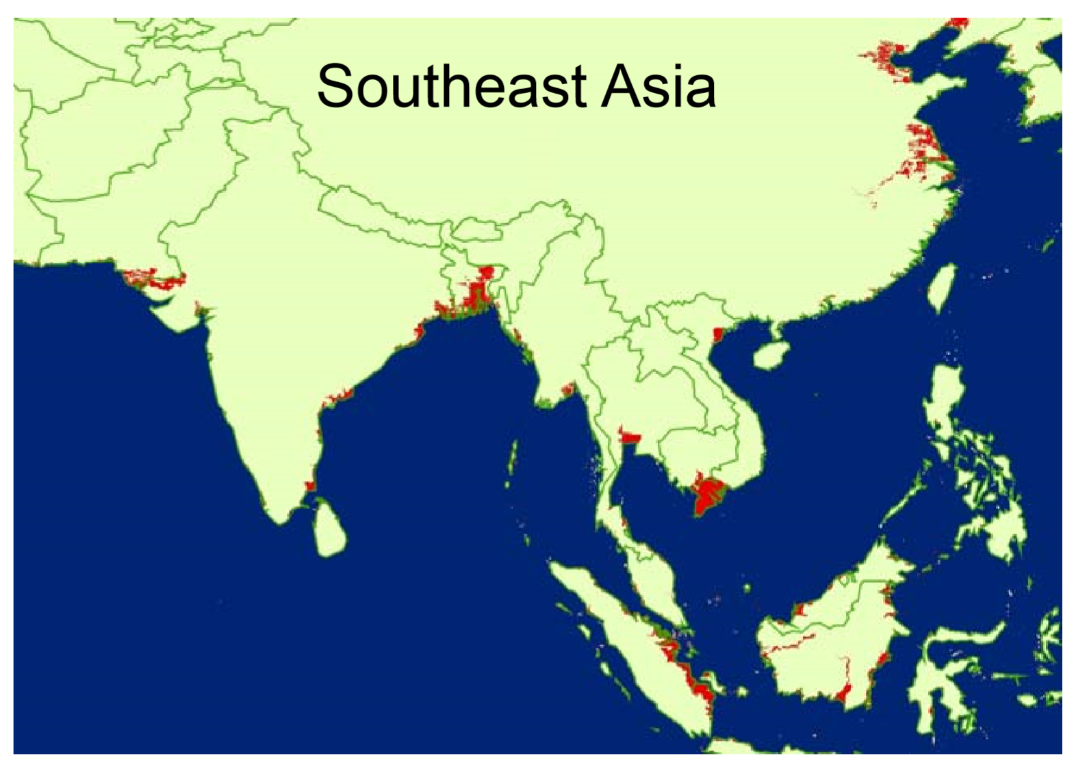

Slide 58
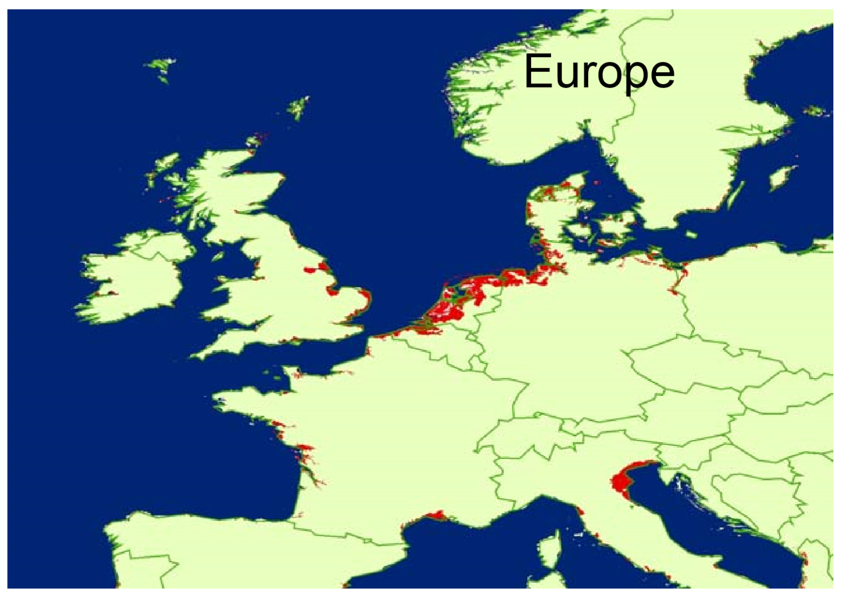

Slide 59
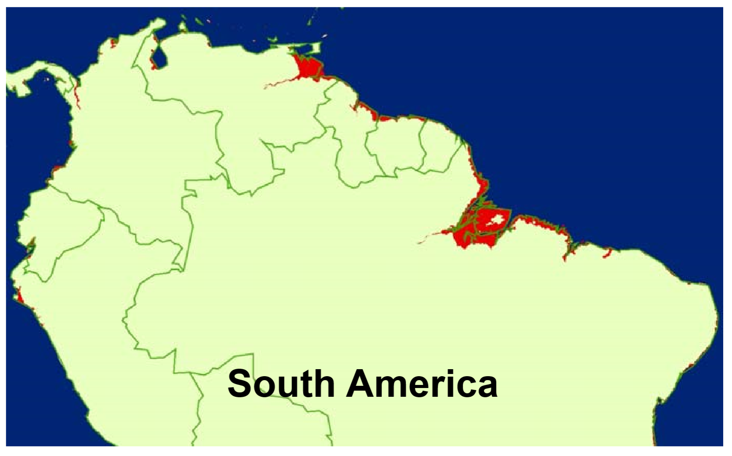

Slide 60
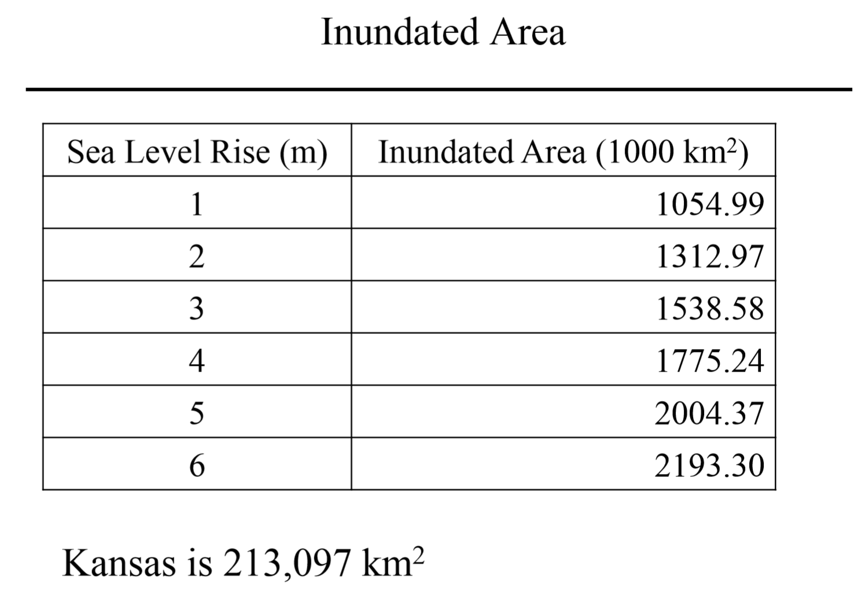

Slide 61
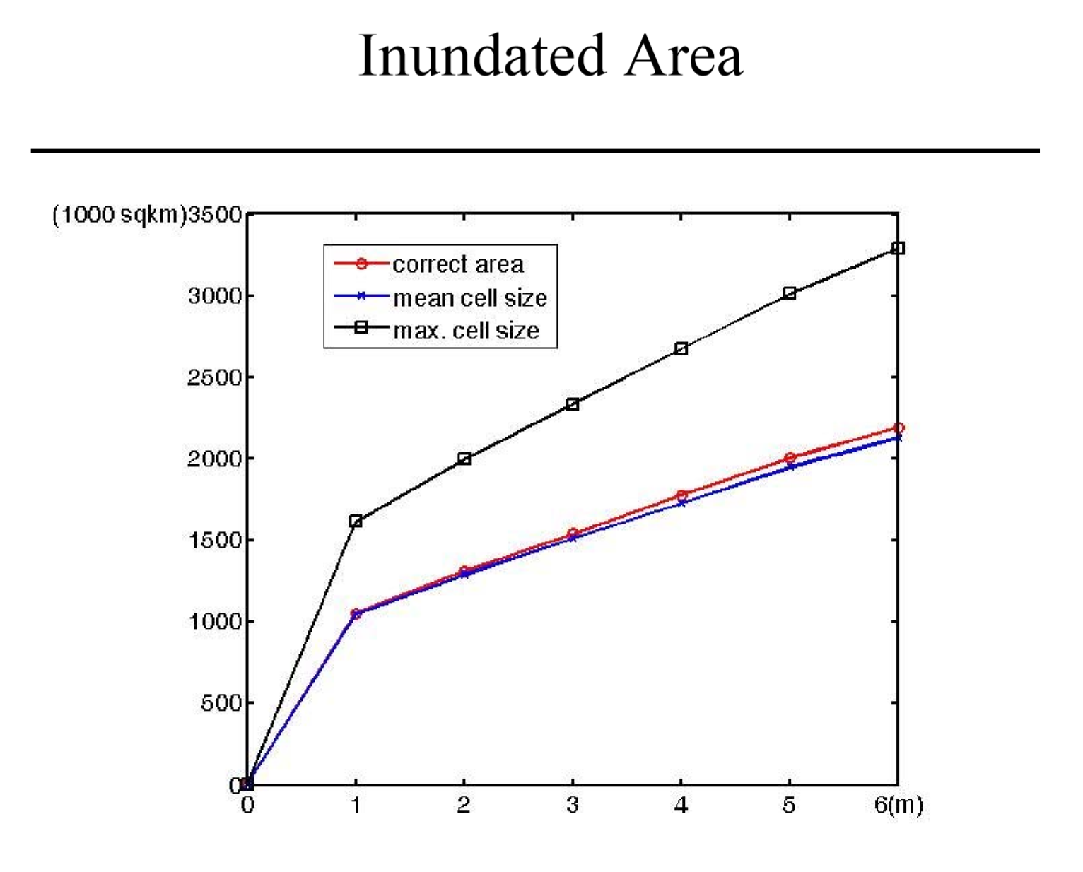

Slide 62
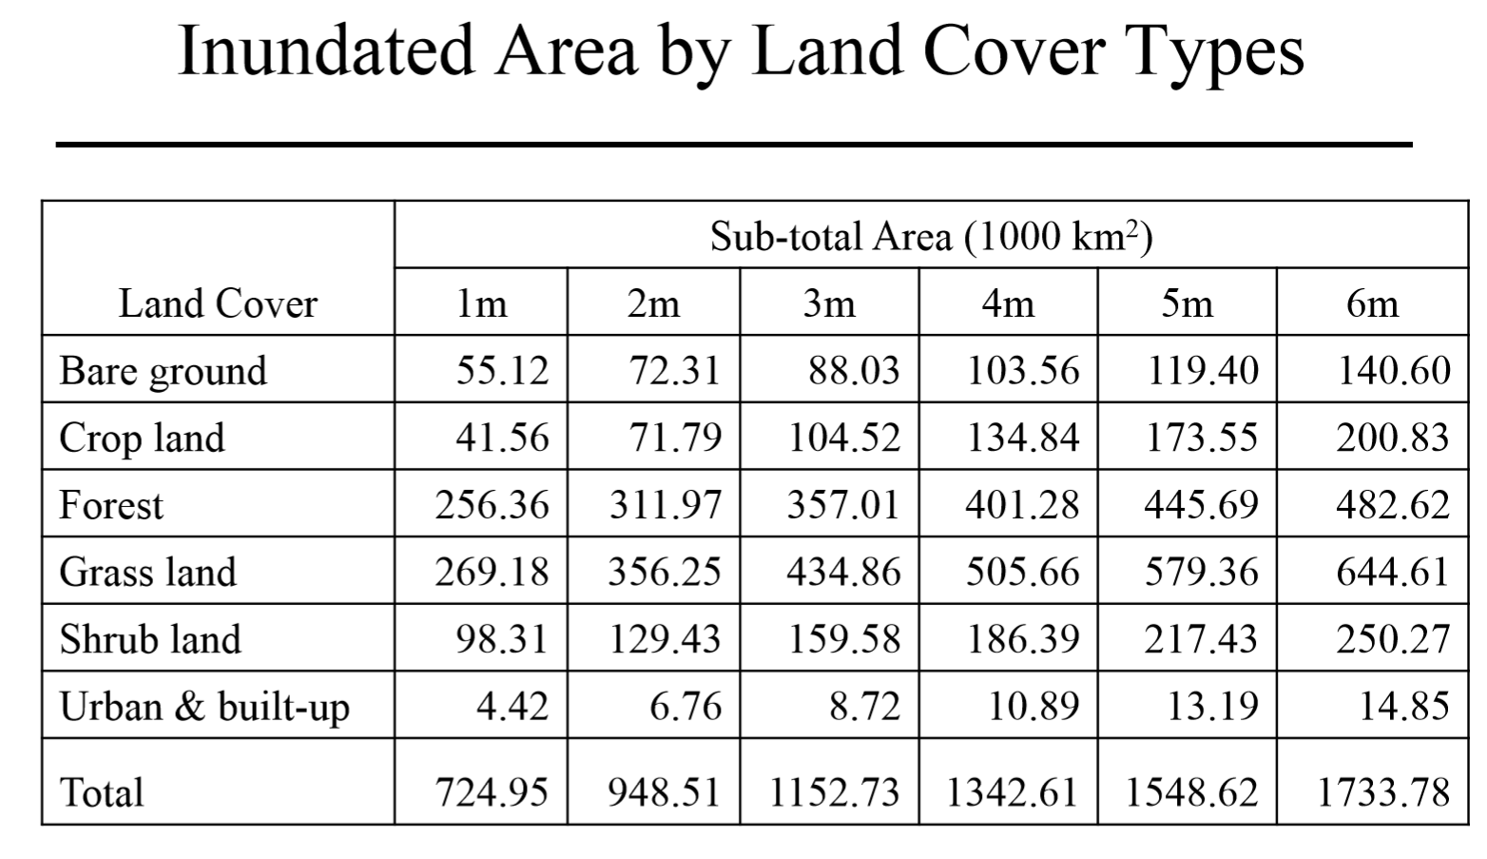

Slide 63
